Slide 1


The 1st Competition on
Critical Assessment of Data Privacy and Protection
The privacy workshop is jointly sponsored by iDASH (U54HL108460) and
the collaborating R01 (R01HG007078)

Slide 2
Human Genome Privacy
Human DNA are important to the genomic research,
biomedical research, etc., and becoming part of HER
  Prominent examples: Genome-wide association studies (GWAS)
However, genomic data are also highly sensitive
  Personally identifiable markers: skin, hair color…
  Disease markers
    What if your insurance company knows?

Slide 3
Grand Challenge
How to share genomic data in a way that preserves the privacy of the data donors, without undermining the utility of the data or impeding its convenient dissemination?

Slide 4
Aggregation and Anonymization
Simple data aggregation
  E.g., release of allele frequencies aggregated over a group of participants
  Aggregated data are considered to be less sensitive than raw data
Privacy threat: statistical inferences, e.g.,
  Homer’s attack on aggregated raw data ¹
  Our work on the test statistics reported from a GWAS ²
A popular solution: data anonymization through noise adding
  E.g., adding Laplacian noise to achieve differential privacy
Homer N, et al. Resolving individuals contributing trace amounts of DNA to highly complex mixtures using high-density SNP genotyping microarrays. PLoS Genet. 2008;4:e1000167.
Rui W, et al. "Learning your identity and disease from research papers: information leaks in genome wide association study." Proceedings of the 16th ACM conference on Computer and communications security. ACM, 2009.

Slide 5
Utility and Privacy Balance
Noise adding brings in artifacts to human genome data, degrading its utility
Questions: whether those techniques can be used to support biomedical research in practice

Slide 6
The 1st CADPP Competition
Evaluate how effective the best security technologies could be in protecting patient privacy and preserving data utility
The first challenge focuses on the tasks for sharing aggregate SNP data (allele frequencies) for GWAS studies

Slide 7
Real Study, Real Impacts
Understand the impacts of data anonymization to real-world study:
  real human genomic data
  high dimension of a practical scale (involving up to 100K SNPs)
Balance privacy protection and utility
  Goal: maximum utility with minimum controlled privacy risks

Slide 8
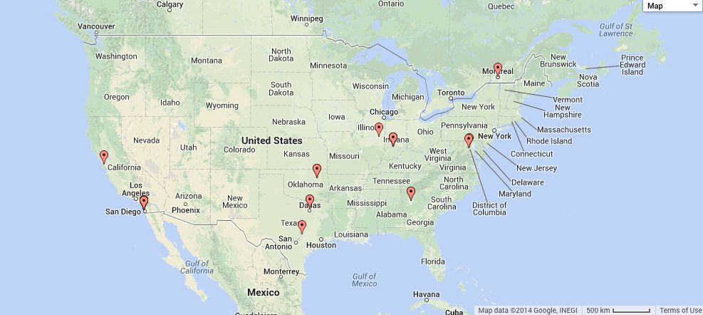
Workshop preparation and registration statistics
3/24
2 countries
9 states
33 registrations

Slide 9
Teams and Tasks
6 teams
  U. Oklahoma
  UT Dallas
  McGill University
  CMU
  UT Austin
  IU (Baseline)
Scenarios: Privacy Protection for GWAS
  Task 1: raw data sharing
  Task 2: outcome release

Slide 10
Schedule
9- 9:45 Keynote: Lucila Ohno-Machado
9:45 – 10: 15: Setting the stage
10:25 – 11: 25: Presentations by CMU and UT Austin (delegated by IU)
1 pm - 3pm: Presentations by UT Dallas, U. of Oklahoma, McGill, IU
3:10 – 4:10: Panel discussion
4:20 – 5pm: Summarization

