Slide 1
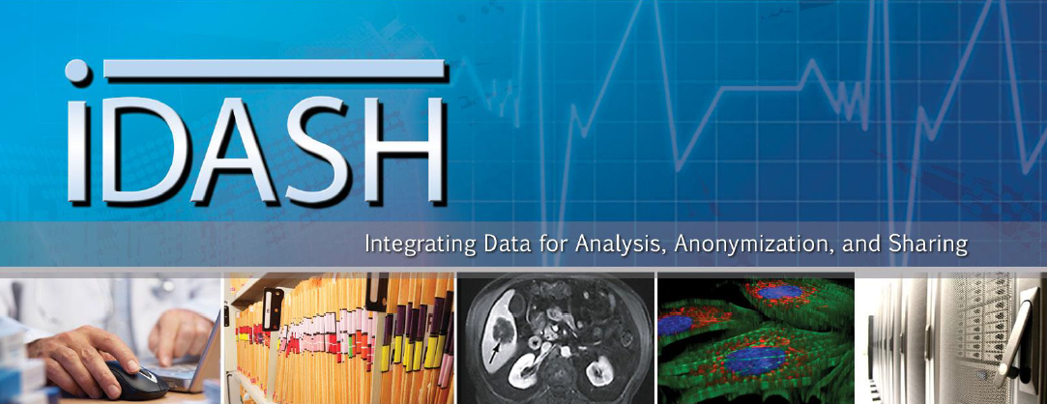
3rd Privacy Workshop
March 24, La Jolla, CA
Lucila Ohno-Machado, MD, PhD
funded by NIH U54 HL108460 University of California San Diego

Slide 2
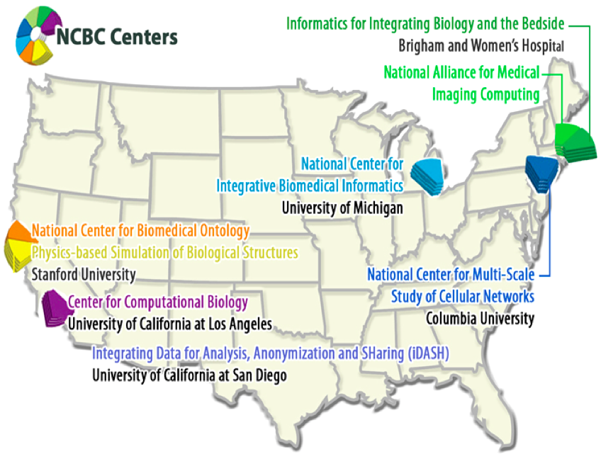

History
Funded by a roadmap initiative of the NIH Office of the Director
Only new NCBC funded in 2010, focused on sharing data & infrastructure

Slide 3
Our Goals
Knowledge & Tools
Privacy
Consent
Data
Share access to data and computation
Train the new generation of data scientists
Provide innovative software, platform, and infrastructure
Protect privacy
  Develop
  Algorithms
  Tools
  Infrastructure
  Policies
Data
Sensors
Genomic
Clinical
iDASH
Knowledge
& Tools
Services
Platform
Platform
Develop.
Federation
Research
Service
WWW
Apps
Exec.
Hosting
Sharing
Policies
Aggreg.
Notes:
iDASH is the newest National Center for Biomedical Computing, an initiative funded orginally by the Office of the Director, and subsequently by a consortium of institutes. Its goal is to allow privacy-preserving sharing of data as well as computational infrastructure, so that biomedical and behavioral sciences can concentrate on their science, while informatics experts take care of infrastructure (hardware, networking) and data sharing tools (software, data use agreements).
A supplement was funded by the NHGRI to demonstrate new models for computing with human genomes in a private cloud environment.
An ethics supplement was funded by the OD to implement patient tiered informed consent for data collected from electronic health records in an Informed Consent Management System.

Slide 4

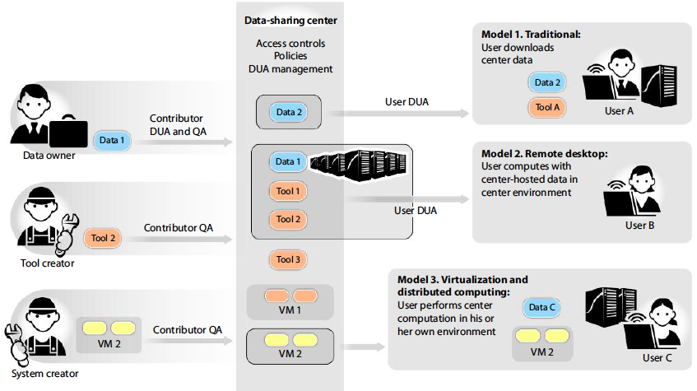
Models for Sharing Data
Ohno-Machado L. To Share or Not To Share: That Is Not the Question. Science Translational Medicine, 2012 4(165)
Notes:
Fig. 1. Data-sharing models. To avoid multiple pairwise agreements among institutions, a broker for data can be created. Data contributors specify
their requirements for data access by users and sign a contributor data use agreement (DUA). Completing a quality assurance (QA) process is required
for data, tool, and VM contributions. Data users also sign a DUA that complies with the requirements of the contributor, so that contributors do not
have to negotiate every data-sharing engagement with different institutions. Three models of sharing are displayed. Model 1 is the traditional model,
in which users download data for use in their local computers. In model 2, the remote desktop model, users connect to a center but access and analyze
data within the center using existing, or their own, algorithms. Model 3 involves virtualization and distributed computation, in which users import
software environments (virtual machines, or VMs) to analyze their data using their local computational infrastructures.

Slide 5
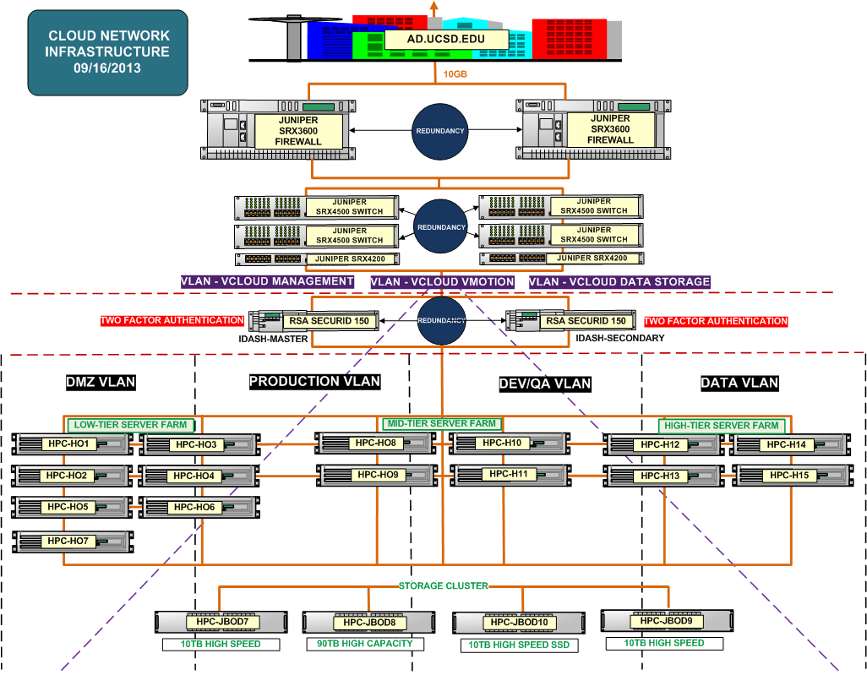
iDASH HIPAA Infrastructure
Redundancy
Encryption at rest/in transit
Centralized logging
Intrusion detection
Proxies and filters
Hardened (secured) system configurations

Slide 6
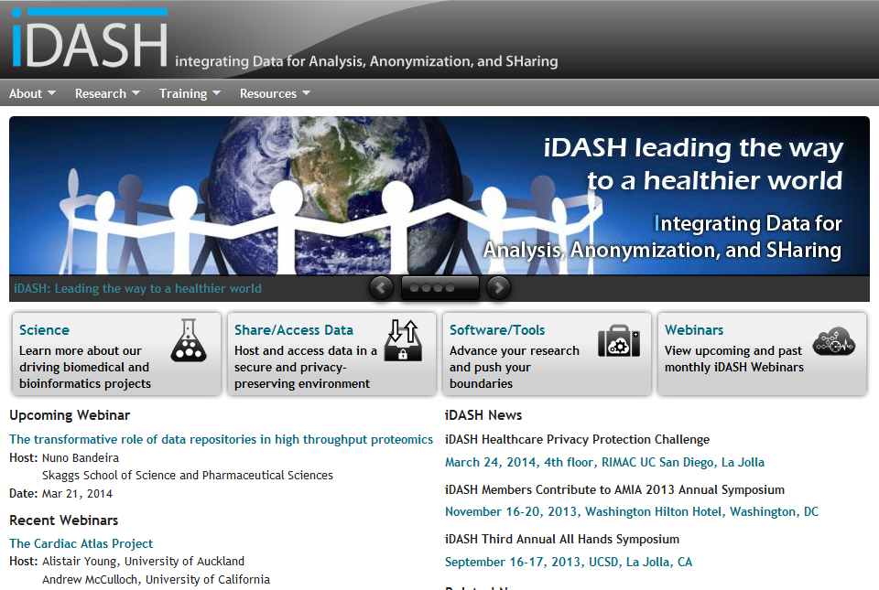
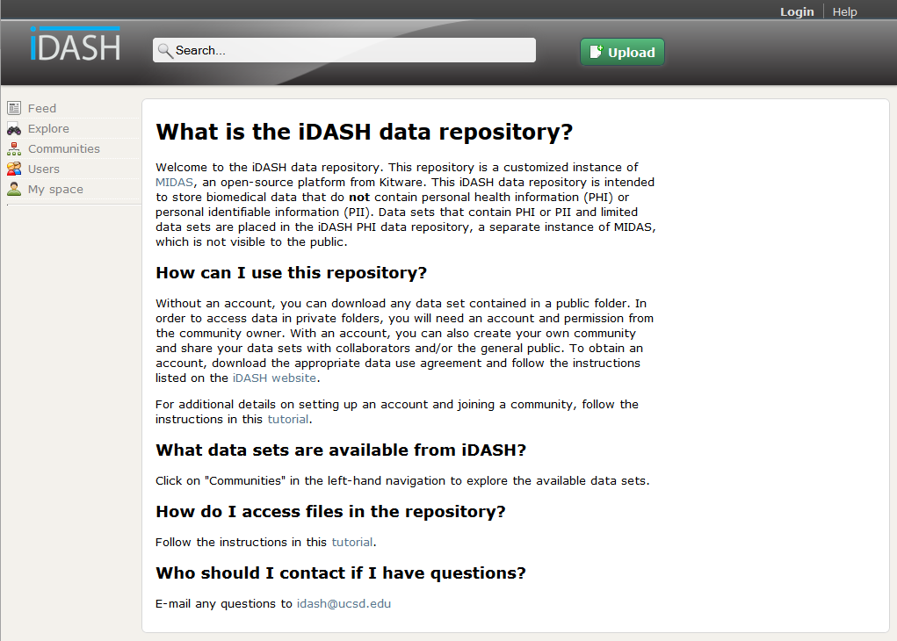


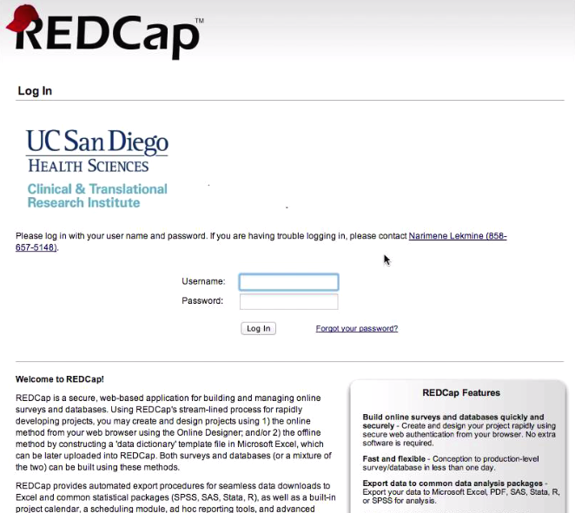
Data Sharing Options
Non-PHI
MIDAS
PHI
Dual Firewall + VPN
Two-Factor Authentication
PHI

Slide 7
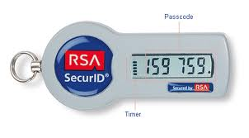
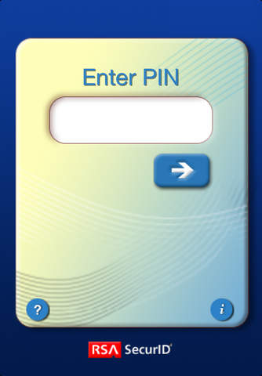
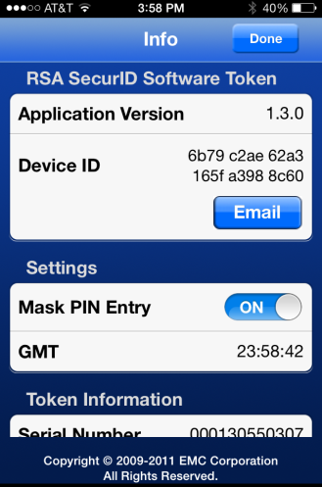
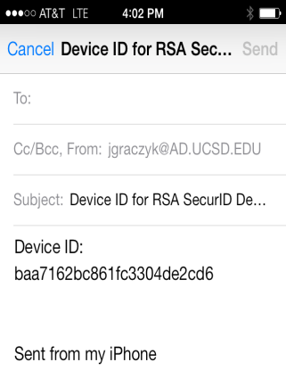

Two-Factor Authentication
RSA tokens (smartphone or physical)
  Available on Apple iOS and Android devices
  Does not require constant Internet connectivity
  Integrated with our data repositories, RedCap, etc
1
2
RSA Console
3
Logged as Administrator
Setup new PIN for:
DeviceID: xyxyxyxyxyxyx
RSA User: [jsmith]
PIN: [********] [OK]

Slide 8
iDASH Repositories
Based on Kitware MIDAS open-source technology
File-level access control
https://idash-data.ucsd.edu/

Slide 9
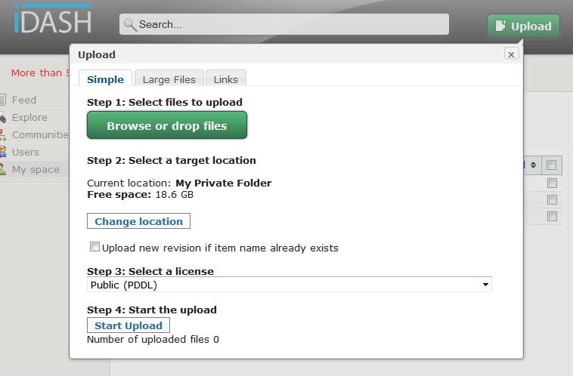
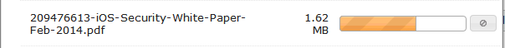
Uploading Data
Built-in web-based upload
2.5GB individual file limit
Multiple file queue with progress indicator
Java applet and command line tool available for larger files/batches
Uploads are Private by default
There are individual and community quotas

Slide 10
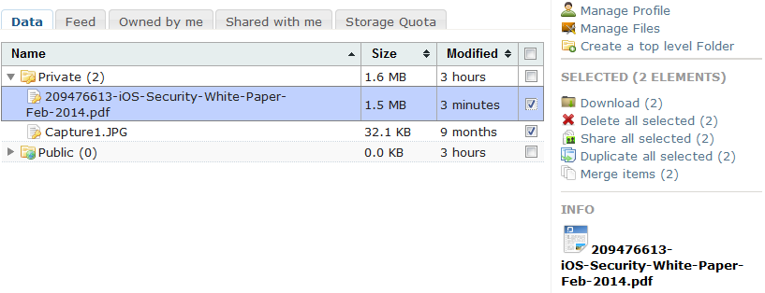
Download Data
Multiple file support
On-the fly compression (ZIP)
Latest version by default
Older versions accessible through View/Download Actions
Downloads available in folders and on items with Read permissions

Slide 11
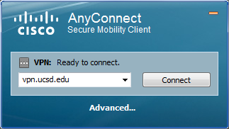
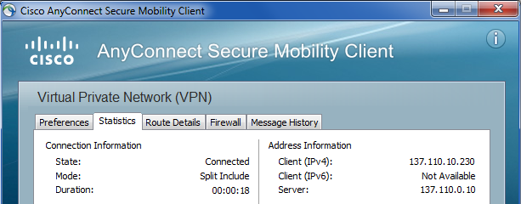
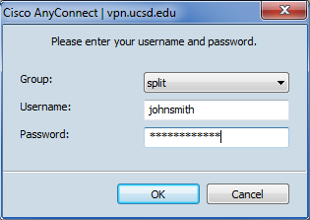
Accessing Protected Resources
Cisco AnyConnect VPN client
  http://blink.ucsd.edu/technology/network/connections/off-campus/VPN/index.html
1
3
2
1 connect
2 use your AD credentials
3 check the Client IPv4 address X.Y.10.Z

Slide 12
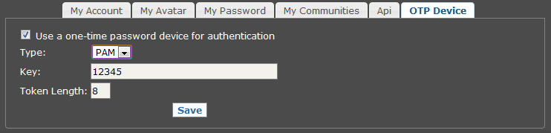
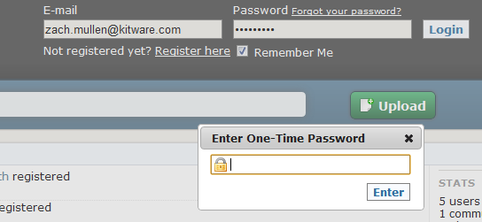
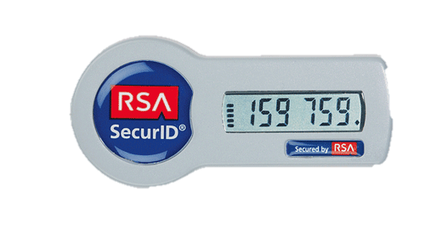
Security enhancements
LDAP, RADIUS/PAM two-factor authentication
centralized logging
audit trail
Setup
Use

Slide 13
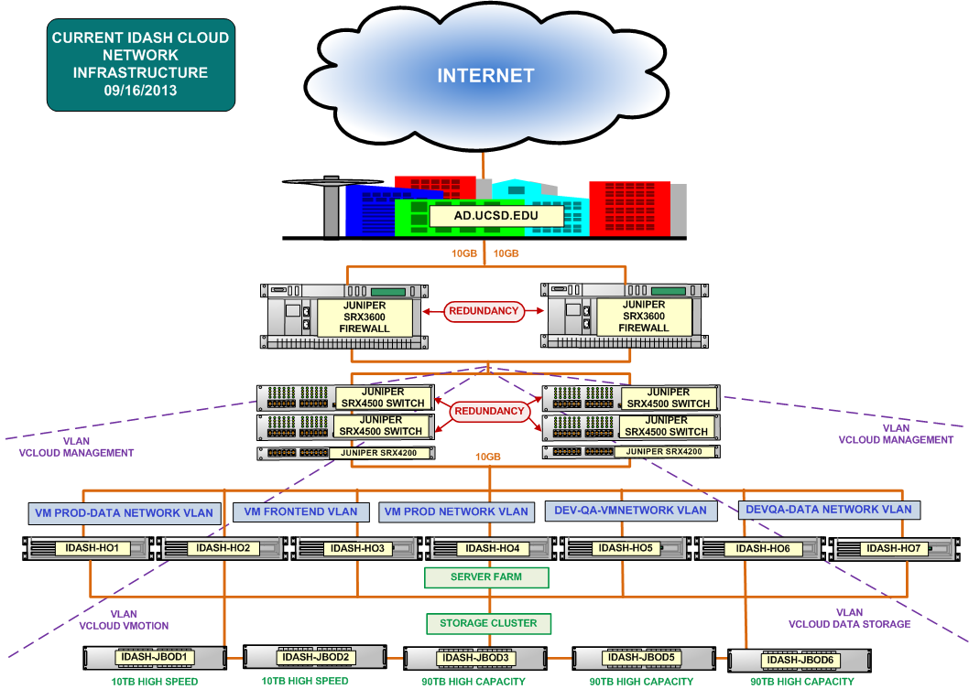
iDASH Prod/Dev Infrastructure
150+ cores
1/2TB+ RAM
300TB+ Storage
Campus Integration
Isolation
10GbE Everywhere
High Availability
Segmentation
Applications
* Subset of HW allocated for the iDASH cloud
Flexible Storage

Slide 14
iDash Cloud Infrastructure
600+ cores
5TB+ RAM
130TB+ Storage
Isolation
Two Factor Auth
VLAN Zones
VMs + Applications
Tiered Computation
Tiered Storage

Slide 15
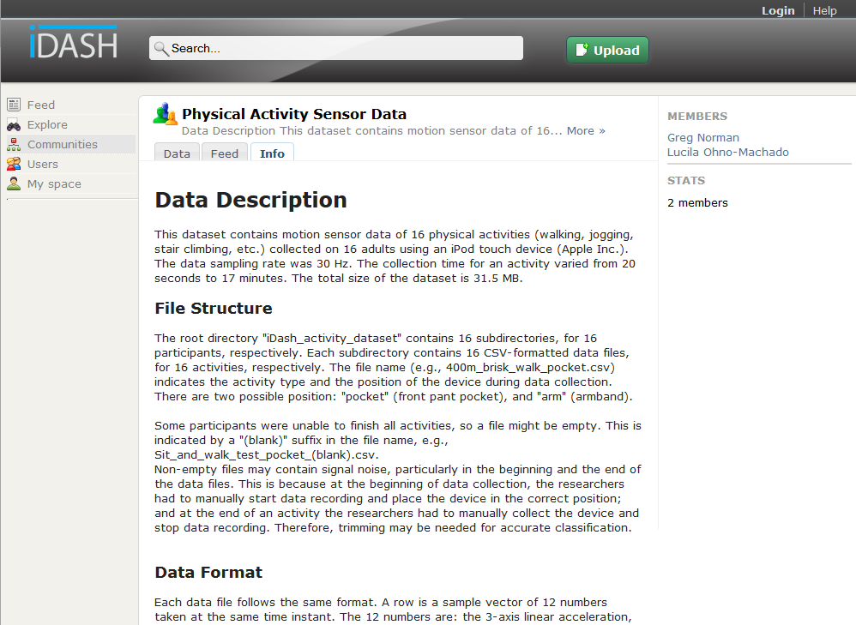
Communities (Groups)
Public community = discoverable by all
Private community = invisible to non-members
Created by repository administrators
Can be managed by selected members
Membership requires invitations
Users can be in multiple communities
Default folders and permissions
  Public = contents visible to all others
  Private = contents accessible to members

Slide 16
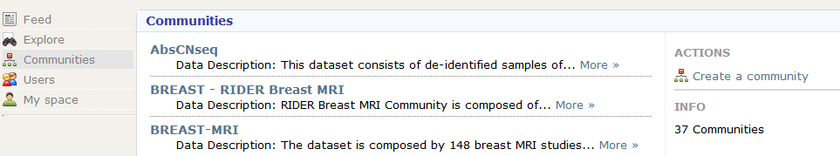
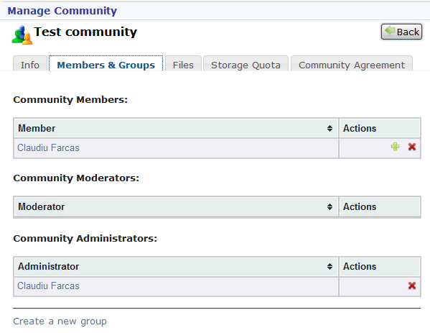
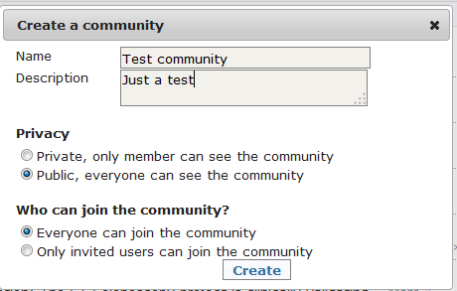
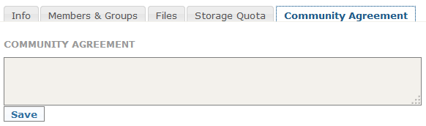
Communities Management
SignedDCA
DUA

Slide 17
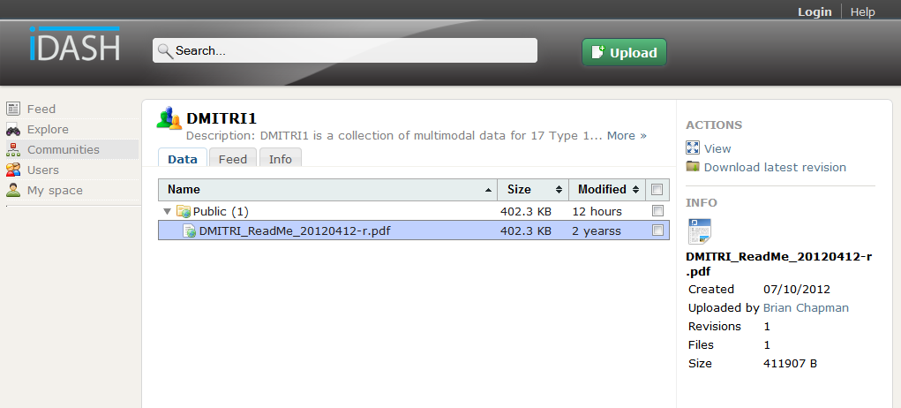
Share data with Communities
Public communities can have private data
Members can share through more than one community
Members have individual Public and Private folders too
Public data encouraged (e.g., description, protocol, readme, etc) for anonymous access
Actions are context sensitive
Items have revisions and metadata

Slide 18
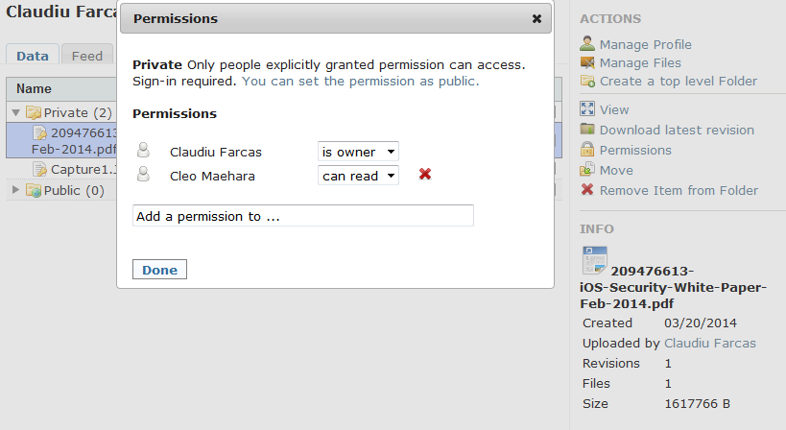
Built-in Permission Models
Permissions per-item and per-folder basis.
Everything is reconfigurable down to the item level
Three states: Own / Edit / Read
Anonymous read permissions = Public

Slide 19
iDASH REDCap
Features:
Online data collection tool (version 5.0.8)
Hosted in the HIPAA compliant iDASH environment
2 factor authentication
Encrypted connection with SSL
An expiry date can be set for user access to a dataset (project)
All user actions are logged for an audit trail
Current Projects:
Kawasaki Disease
  ~1000 patients
  Contains demographic, clinical, lab and echo data
  Emory University is one of our non-UCSD data contributor
Notes:
~10 studies and ~200GB of space. 250MB of used space

Slide 20
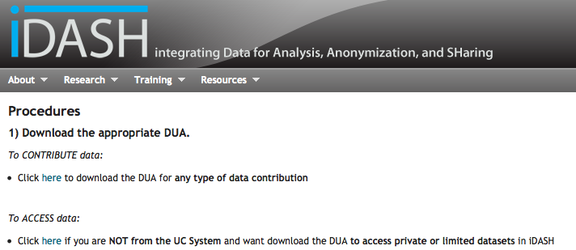
iDASH Data Agreements
Two types of agreements:
  Data Contributor Agreement (DCA)
  Data Use Agreement (DUA)
Vetted and approved by lawyers from UC Office of President and UCSD Office of Contracts and Grants
Agreements are downloadable from iDASH website

Slide 21
Paperwork Workflow
Data Contributor or User
UCSD Office of Contracts and Grants
iDASH Support
Download appropriate agreement
Complete and sign
Review and sign agreement
Create accounts
Obtain signature of organization’s legal authority
Set up and manage community

Slide 22
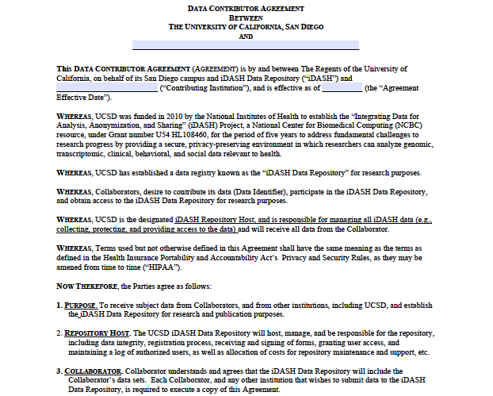
DCA Agreement Terms

Slide 23
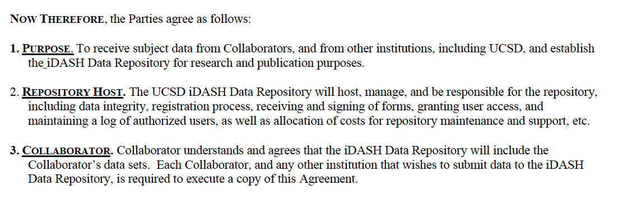
DCA Agreement Terms

Slide 24
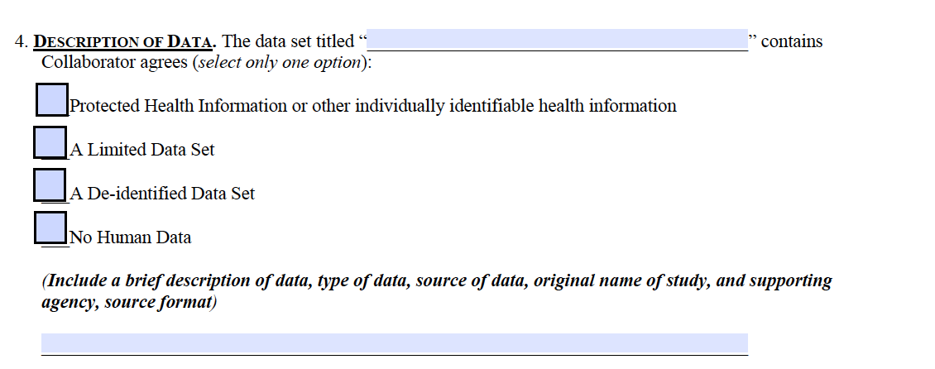
DCA - Description of Data

Slide 25
DCA - Description of Data
Define type of data

Slide 26
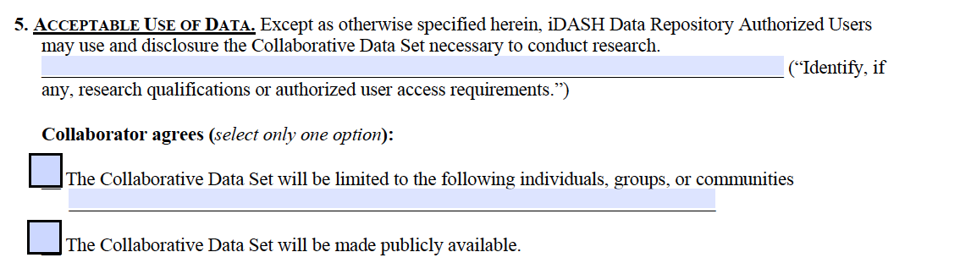
DCA - Acceptable Use of Data

Slide 27
DCA - Acceptable Use of Data
Define level of sharing

Slide 28
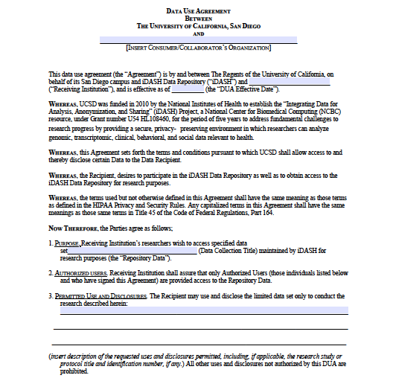
DUA – Agreement Terms

Slide 29
DUA – Agreement Terms

Slide 30
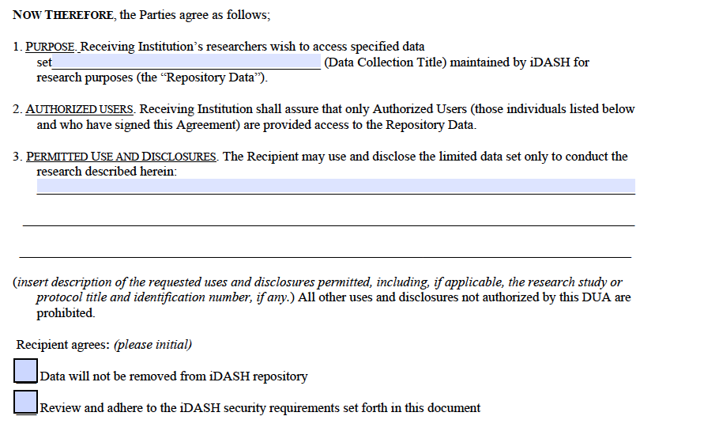

DUA – Agreement Terms

Slide 31
DUA – Agreement Terms
Agreement terms differ from DCA

Slide 32
DUA – Agreement Terms
Additional agreements

Slide 33
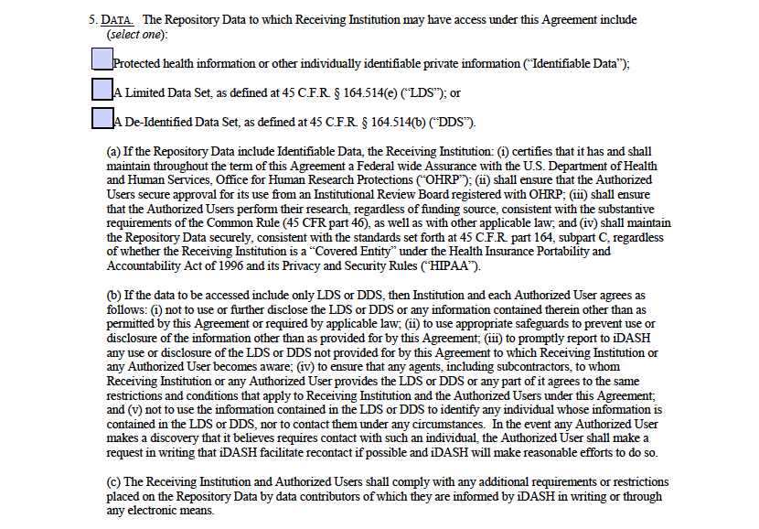
DUA – Description of Accessible Data

Slide 34
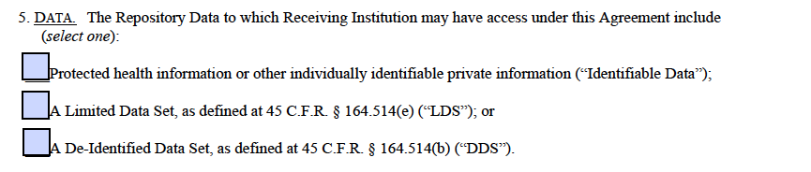
DUA – Description of Accessible Data

Slide 35
DUA – Description of Accessible Data
Define type of data

Slide 36
Institutions with Signed Agreements
DCA
National
  UCSD
  Children’s Health Care of Atlanta (GA)
  Long Beach Veterans Affairs Medical Center
  Ortho Kenematics (TX)
International
  Mahidol University (Thailand)
DUA
National
  UCSD
  Databetes (NY)
  Tin Man Labs, LLC (TX)
  UMass Dartmouth
  Georgia Institute of Technology
  University of Utah
  The Ola Grimsby Institute (CA)
  The Methodist Hospital Research Institute (TX)
  Wake Forest University Health Systems (NC)
International
  North West London Hospitals NHS Trust (UK)
  The University Hospital of Leuven (Belgium)
  INRIA (France)
  Newton Circus Pte. Ltd. (Singapore)

Slide 37
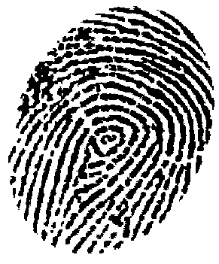


Biometrics and PHI
Biometrics are
Protected Health Information (PHI)
Biometrics require HIPAA
PHI requires HIPAA

Slide 38
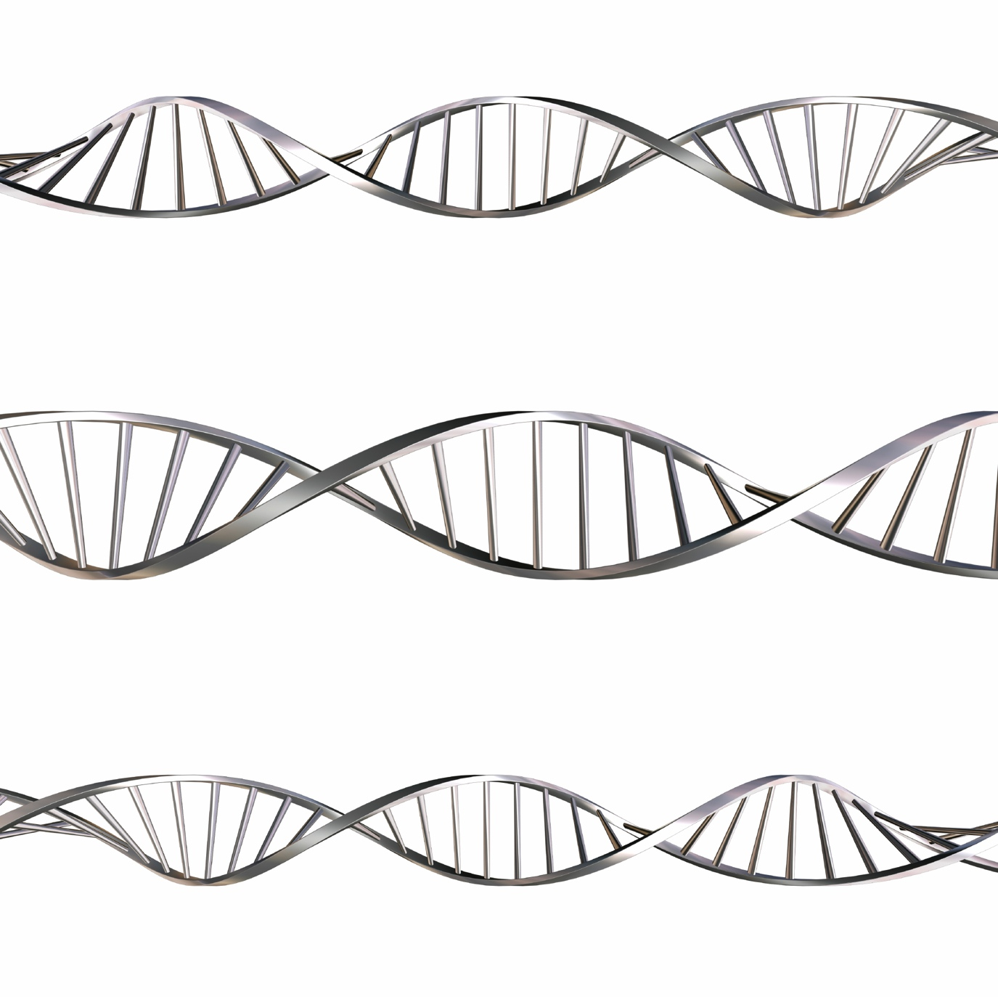
Genomes are Biometrics
Biometrics are
Protected Health Information (PHI)
Biometrics require HIPAA
PHI requires HIPAA

Slide 39
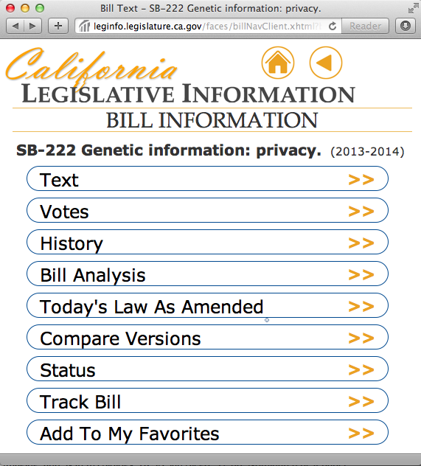
This bill would enact the Genetic Information Privacy Act, which would declare that an individual’s genetic information is protected by the right of privacy. The bill would prohibit any person from collecting, storing, analyzing, or disclosing genetic information without the written authorization of the individual to whom the information pertains, and would include related findings and declarations. It also would prescribe specific circumstances under which genetic information may be collected, stored, analyzed, or disclosed without the authorization.

Slide 40
California Proposed Senate Bill on Genetic Information Privacy
(c) The commission urges federal and state governments to ensure a consistent floor of privacy protections covering whole genome sequencing data regardless of how they were obtained.
(d) Policies should protect individual genetic information by prohibiting the unauthorized use of surreptitious collection.
(e) It is the intent of the Legislature to enact legislation that would protect individuals from the unauthorized collection, storage, and disclosure of their genetic information.

Slide 41
(f) It is the intent of the Legislature to enact legislation that would ensure that genetic information is personal information that is not collected, stored, or disclosed without the individual’s authorization.
(h) It is the intent of the Legislature to enact legislation that would promote the use of genetic information for legitimate reasons, including, but not limited to, health care, research, advancement of medicine, and educational purposes, as the field of genomics advances.

Slide 42
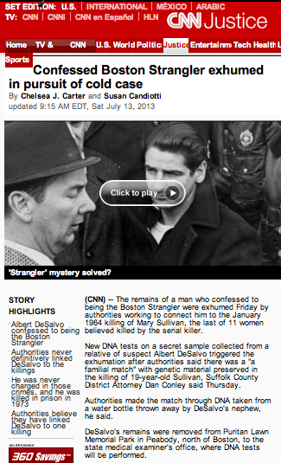
New DNA tests on a secret sample collected from a relative of suspect Albert deSalvo triggered the exhumation after authorities said there was a “familial match” with genetic material preserved in the killing of Sullivan…
Authorities made the match through DNA taken from a water bottle thrown away by DeSalvo’s nephew…
But a lawyer for the DeSalvos told CNN the family was “outraged, disgusted and offended” by the decision to secretly take a DNA sample of one of its members…

Slide 43
Excerpt from a consent for care form
USE OF MEDICAL INFORMATION AND SPECIMENS:
I understand that my medical information, photographs, and/or video in any form may be used for other [INSTITUTION] purposes, such as quality improvement, patient safety and education. I also understand that my medical information and tissue, fluids, cells and other specimens (collectively, "Specimens") that [INSTITUTION] may collect during the course of my treatment and care may be used and shared with researchers.

Slide 44
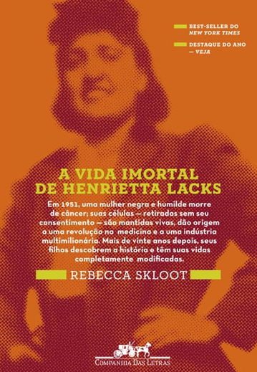
I understand that under California law, I do not have any rights to any commercially useful products that may be developed from such research. I further understand that any use of my medical information or Specimens by [INSTITUTION] or other research institutions will be in accordance with state and federal law, including all laws and regulations governing patient confidentiality, in the manner outlined in the [INSTITUTION] Notice of Privacy Practices.

Slide 45
Excerpt from a Notice of Private Practices
Enrollment in [research] studies can only occur after you have been informed about the study, had an opportunity to ask questions, and indicated your willingness to participate by signing a consent form. When approved through a special review process, other studies may be performed using your medical information without requiring your consent. These studies will not affect your treatment or welfare, and your medical information will continue to be protected.

Slide 46
Questions about clinical data sharing
Which types of use require IRB approval?
  Quality improvement
  Research
  Public health
Which types of data sets could be used for research without patient consent?
  De-identified
  Limited
  c. Identified
What are the implications of improper disclosure?
Can healthcare institutions honor individualized patient preferences?

Slide 47



Shifting control
Patient Interface
Healthcare Institutions
Consent Management System
Do I wish to disclose data D to U?
Yes
Trusted broker
Data use agreements
Study registry
Sharing Look-up
User U requests Data D on individual I
Patient I
I can check that U looked at my data D

Slide 48
informed CONsent for Clinical data Use for Research
iCONCUR
Consent
Management
System
Trusted Entity
Query
Connecting Software
Concierge or
Automated Services
Clinical Data Warehouse
Sharing
Look-up
Registry
Results
Patient I
User U
Electronic Health Record
Healthcare Institution

Slide 49
Patient-centered data sharing
Year 1
iPad Consent Application
Data Use Agreements
Year 2
Consent Ontology
Educational Materials
Year 3
Consent Builder
Data Warehouse Sharing Preferences
Year 4
Healthy volunteer preferences
New driving biological projects (DBPs)

Slide 50
Privacy & Technology Projects
Privacy Preserving Analytics for KD in African-Americans
Consent for Data and Biosample Sharing in an Underserved Population
Partnership for Epidemiological Research on Latinos
Which DNA variants are implicated in KD susceptibility in this population?
Emory, Genome Institute of Singapore, Imperial College
Does consent rate depend on who is obtaining the consent?
Maricopa Health System
Do patients understand what they consented for?
San Diego State University
Data and Biospecimen Sharing
Privacy Preserving Computation

Slide 51
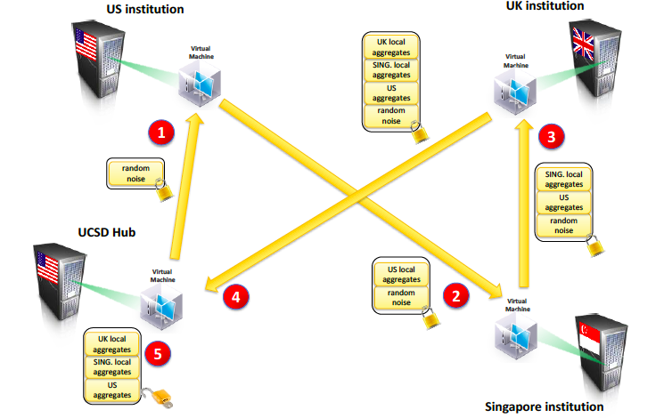
Privacy Preserving Analytics for Kawasaki Disease in African-Americans
UCSD Jane Burns, MD Emory University David Lloyd, MD
Privacy Preserving Analytics for Kawasaki Disease in African- Americans
iDASH Partnership for Epidemiological Research in Hispanic/Latinos
Informed Consent for Biospecimen Collection and Data Sharing among Low-income, Uninsured and Underinsured Women: Is it a Matter of Trust?

Slide 52
Partnership for Epidemiological Research in Latinos
San Diego State University Greg Talavera, MD
FISMA Cloud
Ohno-Machado L. To Share or Not To Share: That Is Not the Question. Science Translational Medicine, 2012 4(165)
Notes:
Fig. 1. Data-sharing models. To avoid multiple pairwise agreements among institutions, a broker for data can be created. Data contributors specify
their requirements for data access by users and sign a contributor data use agreement (DUA). Completing a quality assurance (QA) process is required
for data, tool, and VM contributions. Data users also sign a DUA that complies with the requirements of the contributor, so that contributors do not
have to negotiate every data-sharing engagement with different institutions. Three models of sharing are displayed. Model 1 is the traditional model,
in which users download data for use in their local computers. In model 2, the remote desktop model, users connect to a center but access and analyze
data within the center using existing, or their own, algorithms. Model 3 involves virtualization and distributed computation, in which users import
software environments (virtual machines, or VMs) to analyze their data using their local computational infrastructures.

Slide 53
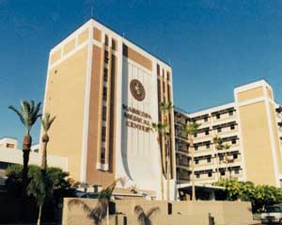
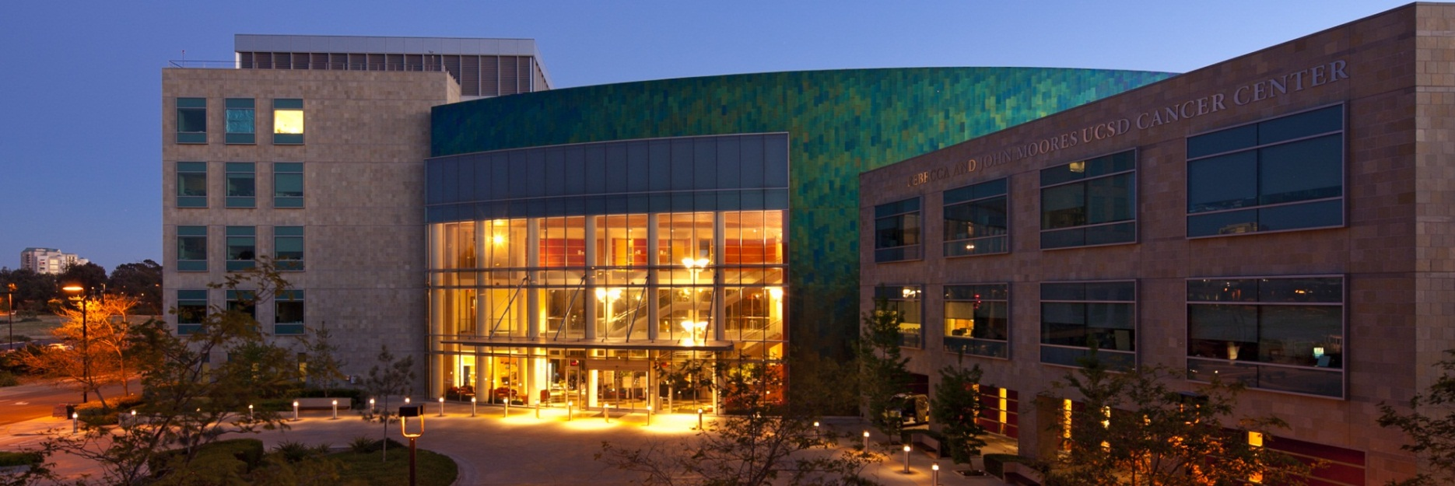
Trusted Parties in Research
Informed Consent for Biospecimen Collection and Data Sharing among Low-income, Uninsured and Underinsured Women:
Is it a Matter of Trust?
Maricopa Health System, AZ Ian Komenaka, MD
UCSD Moores Cancer Center, CA Maria Elena Martinez, PhD

Slide 54
Training: Intern Projects 2013
Data Sharing
Algorithms and Tools
Genomics
Privacy
Knowledge Sharing Impact in Biomedical Literature
Privacy Preserving SVM using Public and Private Datasets
Genomic Privacy Protection Using Compressed Sensing
Data-Driven Prognostication Tool
Genomics and Glucose Control in Diabetes
Consent
Form Builder
Physician Re-Access of Patient Charts
Usability Evaluation Tool
Tiered Consent Patient Preferences

Slide 55
Data sharing models
Ohno-Machado L. To Share or Not To Share: That Is Not the Question. Science Translational Medicine, 2012 4(165)
Notes:
Fig. 1. Data-sharing models. To avoid multiple pairwise agreements among institutions, a broker for data can be created. Data contributors specify
their requirements for data access by users and sign a contributor data use agreement (DUA). Completing a quality assurance (QA) process is required
for data, tool, and VM contributions. Data users also sign a DUA that complies with the requirements of the contributor, so that contributors do not
have to negotiate every data-sharing engagement with different institutions. Three models of sharing are displayed. Model 1 is the traditional model,
in which users download data for use in their local computers. In model 2, the remote desktop model, users connect to a center but access and analyze
data within the center using existing, or their own, algorithms. Model 3 involves virtualization and distributed computation, in which users import
software environments (virtual machines, or VMs) to analyze their data using their local computational infrastructures.

Slide 56
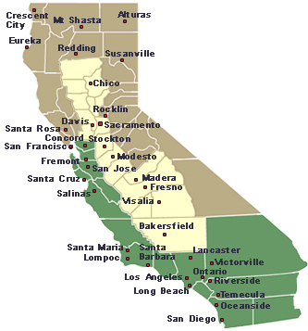
Clinical Data Network – UC-ReX
Clinical Data Warehouses from 5 Medical Centers and affiliated institutions exchange (>12 million patients)
Improve patient safety surveillance, quality improvement, translational research
Funded by the UC Office of the President

Slide 57


UC-Research eXchange
Researcher wants data about population
Registries, other DBs
UCSD
(Epic)
UC Irvine
(Allscripts)
Community Partners
UC Davis
(Epic)
UCSF
(Epic)
Data Matching Function: Map D onto data dictionaries, use Data Warehouses derived from EHR
Request for Data on Cohort
Results on Harmonized Data
  Currently
    Count queries
  Future steps
    Individual-level patient data delivery
    Cross-institutional analytics

Slide 58

Quality improvement/health services research?
User requests data for Quality Improvement or Research
Are the data accessible?
How many patients over 65 are on Warfarin or Dabigatran?
What are the major and minor bleeding rates for patients on these drugs?
Trusted Broker(s)
Identity & Trust Management
Policy enforcement
Security Entity
Diverse Healthcare Entities
in 3 different states
(federal, state, private)
AHRQ R01HS19913 / EDM forum
Count queries and statistics across data warehouses

Slide 59
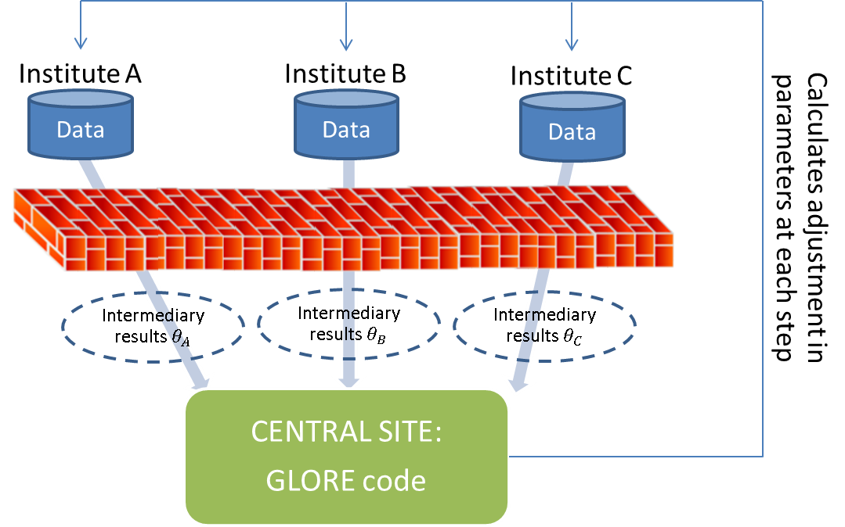

Privacy-preserving distributed computing
Predictive modeling and adjustment for cofounders require lots of data
Some institutions cannot move data outside their firewalls
We can bring computation to the data
User requests data for Quality Improvement or Research
Diverse Healthcare Entities
in 3 different states (federal, state, private)
Trusted Broker(s)
Identity & Trust Management
Policy enforcement
Security Entity
AHRQ R01HS19913 / EDM forum
Distributed regression models
Wu Y et al. Grid Binary LOgistic REgression (GLORE): Building Shared Models Without Sharing Data. JAMIA 2012
Scalable National Network for
Comparative Effectiveness Research

Slide 60
pSCANNER CDRN patient-centered SCAlable National Network for Effectiveness Research approved for funding by PCORI as part of PCORnet
Members: 5 UCs, National VA (VINCI resource), 3 Federally Qualified Health Systems in LA (USC), RAND
Cohorts: Kawasaki Disease, Congestive Heart Failure, Obesity
TCC: The Children’s Clinic VM: Virtual Machine
SFGH: San Francisco General Hospital OMOP: Observational Medical Outcomes Partnership

Slide 61
Shifting Control
Patient Interface
Healthcare Institutions
Consent Management System
Do I wish to disclose data D to U?
Yes
Trusted broker
Data use agreements
Study registry
Sharing Look-up
User U requests Data D on individual I
Patient I
I can check that U looked at my data D

Slide 62
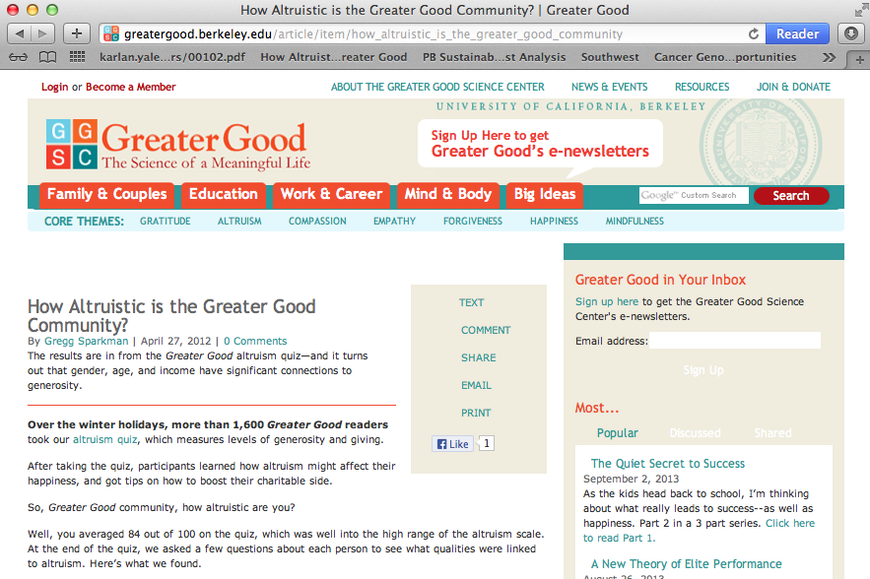
Sharing Behavior of Healthy Individuals

Slide 63
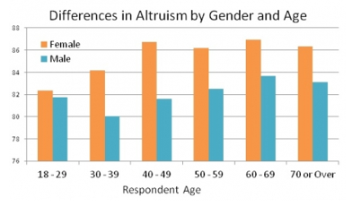
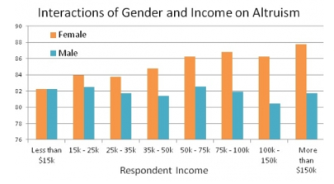
Effect of Age and Gender on Altruism
http://greatergood.berkeley.edu/article/item/how_altruistic_is_the_greater_good_community

Slide 64
Tiered or Granular Consent
Tiered consent provides different choices for participants so that they can select their personal preferences.
Ethical guidelines about granular control and patient preferences were considered during development of the tool.^{1,2,3}
Data governance requirements for distributed clinical research networks: triangulating perspectives of diverse stakeholders.⁴
1. Caine K, Hanania R. Patients want granular privacy control over health information in electronic medical records. J. Am. Med. Inform. Assoc. 2013 Jan 1;20(1):7–15.
2. Spriggs M, Arnold M, Pearce C, Fry C. Ethical questions must be considered for electronic health records. J Med Ethics. 38:535–9.
3. E.M. Meslin, et al., Giving patients granular control of personal health information: Using an ethics ‘Points to Consider’ to inform informatics system designers, Int. J. Med. Inform. (2013)
4. Kim et al, JAMIA online first (2014)

Slide 65
What to share / Who to share with
Healthy volunteers do not want to share with commercially sponsored researchers
Some want their medical information shared with only UCSD researchers, no others
Many do not want to share at least 1 category of sensitive information
Most common decline was genetic, followed by sexual & reproductive health
Courtesy of E Bell

Slide 66

Courtesy of A Grando

Slide 67
informed CONsent for Clinical data Use for Research
iCONCUR
Consent
Management
System
Trusted Entity
Query
Connecting Software
Clinical Data Warehouse
Concierge or
Automated Services
Sharing
Look-up
Registry
Results
Patient I
User U
Electronic Health Record
Healthcare Institution
Supported by the NIH Grant U54 HL108460 to the University of California, San Diego

Slide 68

Looking into the Near Future
Healthcare data and Biospecimen collections
Several terabytes of data are being generated every day and samples are being collected
Genomes
Images
Body sensors
Environmental sensors
Electronic Health Records
Personal Health Records
Pharmacy
Social media

Slide 69


14 BRIGHT years
Biomedical Research Informatics for Global Health Training program
David Bila, PhD, Universidade Eduardo Mondlane
Lucila Ohno-Machado, MD, PhD, UC San Diego
Heimar Marin, RN, PhD, Universidade Federal the São Paulo
funded by NIH D43TW007015

Slide 70

Open Source Software

Slide 71
Informatics Training for Global Health
funded by NIH D43TW007015

Slide 72









Lábrea, Amazonas
Breves, Pará
Universidade
Aberta
Palmas, Tocantins
São Carlos, São Paulo

Slide 73


iPods and iPads for Online Resources

Slide 74


Slide 75




Introductory Course in Health Informatics

Slide 76

Acknowledgements: DBMI
Unit of the Department of Medicine and of the CTRI since 2009, funded by
    NCATS UL1, NHLBI U54, UH3, NHGRI U01, NLM T15, R00, K22, Fogarty D43,
    UCBRAID/OP, PCORI

Slide 77

Sharing to Promote Health and Accelerate Cure
Informatics Without Borders

