Slide 1
Setting the Stage
Haixu Tang, Shuang Wang, and XiaoFeng Wang

Slide 2
Outline
Data and Methodology
Participants and Results
Discussion

Slide 3
Data and Methodology

Slide 4
Data Selection
Data source
411 Cases from Personal Genome Project (PGP:http://www.personalgenomes.org/)
174 Controls from CEU population of International HapMap Project (http://hapmap.ncbi.nlm.nih.gov/)
Summary of case (PGP) data
 | Before preprocess
Participants | 411
Total SNPs | 29757319

Slide 5
Data Preparation
Preprocess of PGP data
SNP sites supported by HapMap
Genotypes supported by HapMap
Genotypes supported by at least 174 participants
Participants supporting at least 90,000 valid genotypes
Missing values filled by using fastPHASE
Summary of case (PGP) data
 | After preprocess
Participants | 201
Total SNPs | 106129

Slide 6
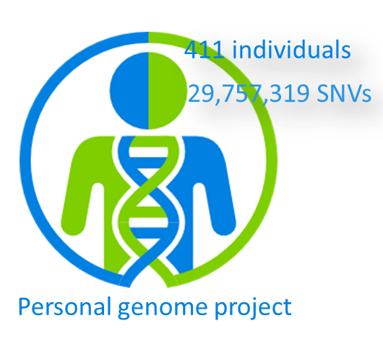
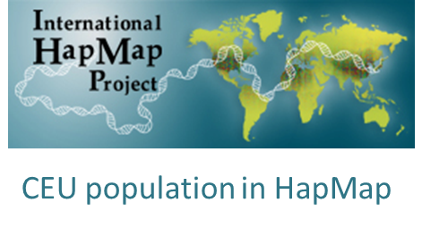
Data preparation
Task 1: data publishing
Case: 200 PGP individuals
Control: 174 CEU individuals
Data set 1: 311 SNVs
Data set 2: 600 SNVs
Filtered and genotyped
Task 2: top-K SNP identification
Case: 201 PGP individuals
Control: 174 CEU individuals
Data set 1: 5000 SNVs
Data set 2: 106,129 SNVs
Overview and methodology papers are under review for BMC Biomedical Informatics and Decision Making

Slide 7
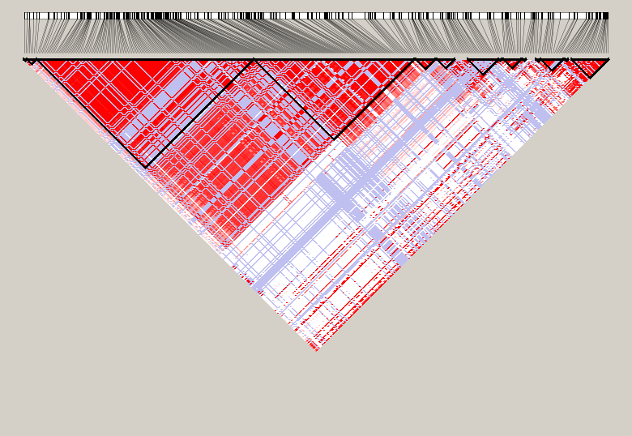
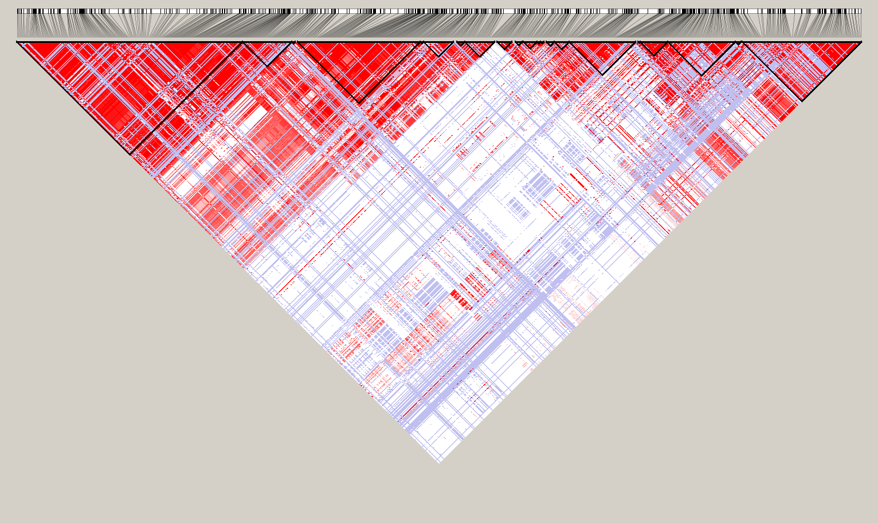
Task 1: Privacy Preserved Data Sharing
Two genomic loci with consecutive SNPs with
Different levels of significance under case-control association tests
High re-identification risk before applying privacy-preserving technologies
Datasets:
Dataset 1
200 participants, 311 SNPs (~29504091-30044866, chr2)
Dataset 2
200 participants, 610 SNPs (~55127312-56292137, chr10)

Slide 8
Challenge of Task 1
Goal: Understand the privacy-utility balance achievable when publicly released SNP data, after proper anonymization, for a realistic GWAS
Utility: the number of significant SNPs identified by the Chi-square association test over the case population (200 individuals from PGP) and a control population (from HapMap)
Privacy Protection: the anonymized data’s resistance to one of the strongest re-identification statistical attack (i.e. the likelihood ratio test).

Slide 9
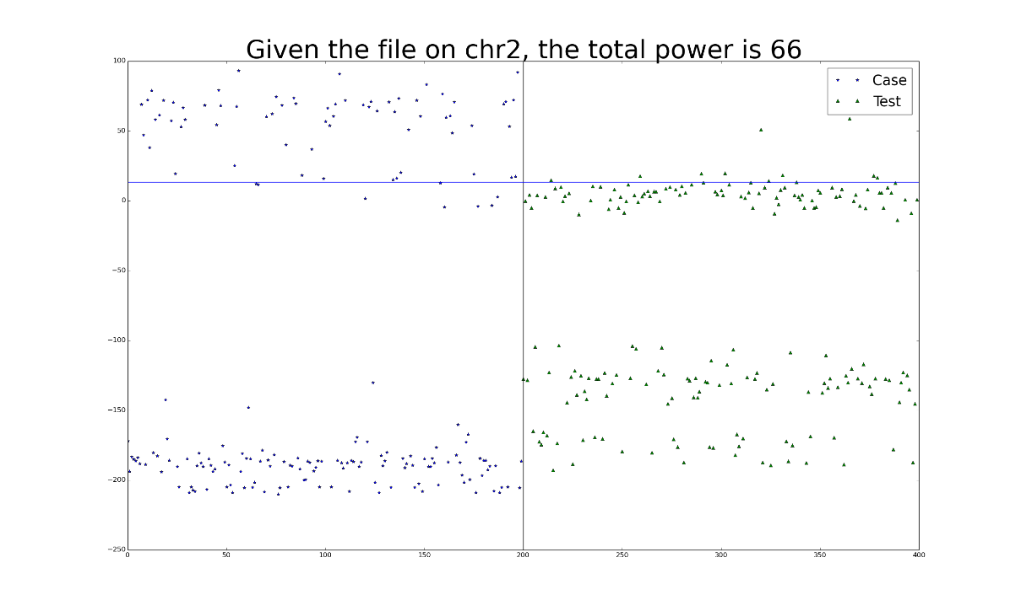
Privacy: Evaluation of Privacy Risks using Likelihood Ratio Test
Implemented as an online tool that allows challenge participants to examine privacy risks in their noise-added data:
http://humangenomeprivacy.org
Sankararaman, S., Obozinski, G., Jordan, M. I., & Halperin, E. (2009). Nature Genetics, 41(9), 965–7. doi:10.1038/ng.436

Slide 10
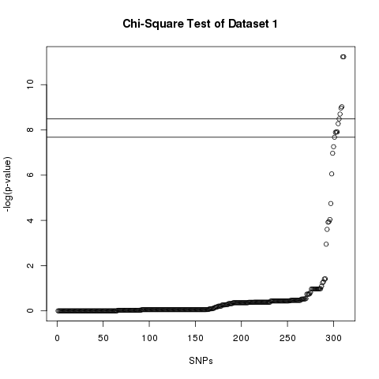
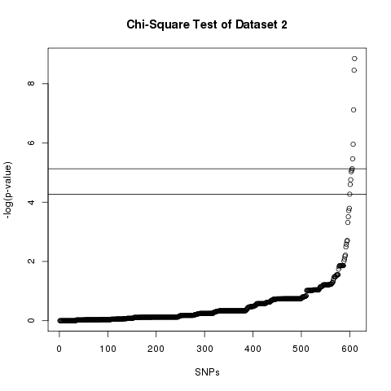
Utility: Case-Control Association Test
Chi-square: , where, r is number of rows , c is
number of columns, O_{i,j} is observed frequencies, E_{i,j} is expected frequencies

Slide 11
Data file released to participants

Slide 12
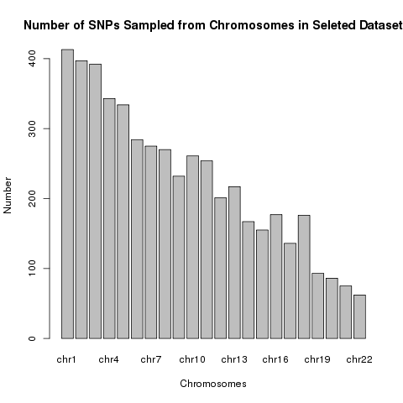
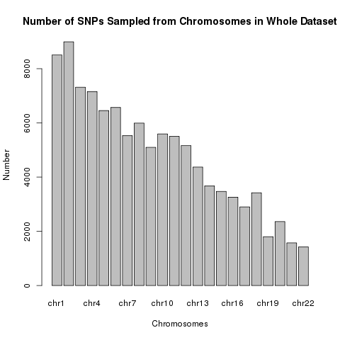
Task 2: Secure Release of Analysis Results
Datasets:
1st Data released to participants:
All valid genotypes on 201 cases and 174 controls
5000 SNPs
Different levels of significances under case-control association tests
2nd Data for test scalability and generalizability:
All valid genotypes on 201 cases and 174 controls
106,129 SNPs
Both data across the whole human genome

Slide 13
Challenge of Task 2
Goal: given a privacy protection standard, evaluate how much utility, in terms of top-K most significant SNPs can be preserved by the best techniques for anonymized outcome release
Utility: top-K most significant SNPs (using chi-square tests) across the genome (e.g., K=1 or 5)
Privacy Protection: Differential privacy with a budget ε=1.0

Slide 14
Data file released to participants

Slide 15
WIDGET: a Web Interface for Dynamic Genome-privacy EvaluaTion

Slide 16
Participants and Results

Slide 17
Teams
Task 1
U. Oklahoma
UT Dallas
McGill University
IU group (Baseline)
Task 2
UT Austin
CMU

Slide 18
Task 1: Privacy Preserved Data Sharing
 |  | Baseline |  |  |  | Group 1 |  | Group 2 |  | Group 3 |  | # of true significant SNPs
 |  | SNP-based |  | Haplotype-based |  | (U. Oklahoma) |  | (UT Dallas) |  | (McGill U.)
Dataset 1 | Power* | 0.05 |  | 0.03 |  | 0.61 |  | 0.04 |  | 0.01
 | Cutoff | TPR | FPR | TPR | FPR | TPR | FPR | TPR | FPR | TPR | FPR
 | 5.00E-02 | 19/263 | 0.844 | 20/197 | 0.612 | 22/294 | 0.941 | 22/269 | 0.855 | 22/278 | 0.886 | 22
 | 1.00E-03 | 12/238 | 0.774 | 19/163 | 0.493 | 19/277 | 0.884 | 19/250 | 0.791 | 18/251 | 0.798 | 19
 | 1.00E-05 | 9/217 | 0.7 | 14/155 | 0.475 | 14/275 | 0.879 | 14/233 | 0.737 | 14/233 | 0.737 | 14
Dataset 2 | Power | 0.04 |  | 0.115 |  | 0.005 |  | 0.01 |  | 0.09
 | Cutoff | TPR | FPR | TPR | FPR | TPR | FPR | TPR | FPR | TPR | FPR
 | 5.00E-02 | 42/565 | 0.924 | 44/499 | 0.804 | 45/587 | 0.958 | 24/24 | 0 | 43/465 | 0.746 | 45
 | 1.00E-03 | 12/526 | 0.862 | 15/437 | 0.708 | 15/557 | 0.909 | 15/15 | 0 | 15/362 | 0.582 | 15
 | 1.00E-05 | 5/480 | 0.788 | 8/312 | 0.504 | 8/536 | 0.876 | 8/8 | 0 | 8/264 | 0.425 | 8
*Re-identification power was calculated at the 0.95 confidence level (i.e., false positive rate of 0.05).

Slide 19
Task 2: Privacy Preserved Feature Selection
 | Teams | Top 1 | Top 3 | Top 5 | Top 10 | Top 15 | Top 20 | Top 30
Small (5000 SNPs) | U. Austin | 1 | 2.66 | 4.44 | 8.48 | 7.07 | 4.68 | 2.37
 | CMU | 0.98 | 2.28 | 3.53 | 7.89 | 4.59 | 2.32 | 1.16
Large (100K SNPs) | U. Austin | 1 | 2.65 | 4.41 | 5.90 | 2.26 | 0.69 | 0.18
 | CMU | 0.98 | 2.26 | 3.56 | 3.27 | 0.42 | 0.15 | 0.07
The numbers in each cell correspond to the averaged number of top K SNPs obtained by each team over 1000 random experiments

Slide 21
Discussion
Task 1
It remains a challenge to privacy-preserved sharing of aggregate human genomic data, while maintaining their utilities in genome-wide association studies (GWAS).
Even for a single genomic locus involving a few hundreds of SNPs, the utility of the data was large damaged after noise-adding to ensure privacy protection
It is un-likely that current privacy-preserving techniques will scale well for sharing whole human genomic data
Task 2
Privacy-preserving techniques work surprisingly well on publishing outcomes of GWAS-like analyses
High accuracy can be achieved when only a small number of most significant SNPs are concerned from the users’ perspective
This task is well aligned with the centralized data/computing model
The centralized data/computing center will host human genomic data as well as service for customized analyses on these data, and will only release the results of these analyses to users
We encourage the community to improve the approaches to this task!

Slide 22
Acknowledgements
Yongan Zhao (Indiana University)
Wei Wei (UCSD)
Zhanglong Ji (UCSD)
Rita Germann-Kurtz (UCSD)
Gail Moser (UCSD)
Son Doan (UCSD)
Funding: iDASH (U54HL108460), NCBC-collaborating R01 (HG007078-01)

