Slide 1
Privacy-Preserving Data Exploration in Genome-Wide Association Studies
Aaron Johnson
Vitaly Shmatikov
Notes:
Because aaron can’t attend this workshop, I’ll present his method and the results of task 2

Slide 2
Background
Main goal: discovering genetic basis for disease
Requires analyzing large volumes of genetic information from multiple individuals
Voluntary and mandated sharing of genetic datasets between hospitals, biomedical research orgs, other data holders
Obvious privacy risks
Notes:
GWAS have become a popular method for analyzing genomic data in order to discover disease-related genetic markers.
A typical study examines a large number of singe-nucleotide polymorphism (SNPs) in a case population of patients with a given disease and a control population without the disease.
To do GWAS, datasets have to be shared between hospitals, biomedical research organizations, and other data holders.
However, the sharing is not safe. We proposed a framework to solve this problem

Slide 3
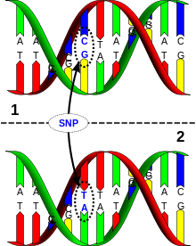
Background: SNP
SNP (single-nucleotide polymorphism):
genetic location with observed human variation
Difference in a single nucleotide
– A, C, T, or G –
between two DNA sequences
Notes:
SNP stands for single nucleotide polymorphism. From the picture, we can see that DNA molecule 1 differs from DNA molecule 2 at a single base-pair location. It’s a C/T polymorphism.
SNPs in the coding region are of two types, synonymous and nonsynonymous SNPs. Synonymous SNPs do not affect the protein sequence while nonsynonymous SNPs change the amino acid sequence of protein.
Variations in the DNA sequences of humans can affect how humans develop diseases and respond to pathogens, chemicals, drugs, and other agents.

Slide 4
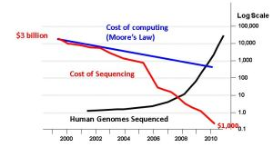
Genome-Wide Association Studies
Cost of DNA sequencing
dropping dramatically
Objective of GWAS:
analyze genomic data to find statistical correlations between SNPs and disease
Notes:
With the phenomenal advance in DNA sequencing technologies, the cost of DNA sequencing is dropping dramatically. More and more human genomic data becomes available.
The objective of GWAS is to analyze genomic data to find statistical correlations between SNPs and disease.
Usually, the number of SNPs in the output of GWAS is much smaller than the total number of SNPs involved in the study.

Slide 5
Case-Control GWAS
Compares the genomes of patients with disease
and the genomes of patients without disease
AACTGTCCG
Case group:
have disease
ACCTGTACG
Control group:
no disease
AATTGTACA
AATTGTCCA
Notes:
Here is a diagram. Researchers collect the genomic data of a group of individuals with a certain disease and another group of individuals without

Slide 6
Finding Disease-Correlated SNPs
Case group:
Control group:
AACTGTCCG
AATTGTACA
ACCTGTACG
AATTGTCCA
Statistical hypothesis:
SNPs are independent
1 | 1 | 0 | 1 | 1 | 1 | 1 | 0
Independence test p-value
Notes:
They then compare two sets of genomic data and find disease-correlated SNPs. In this example, SNPs on position 3 and 8 play a significant role

Slide 7
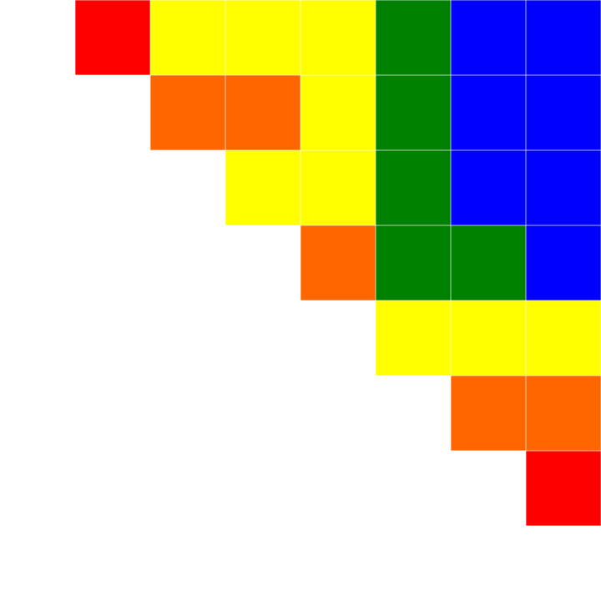
SNP “Heat Map”
SNP #
2 | 3 | 4 | 5 | 6 | 7 | 8
1
2
3
4
5
6
7
High correlation
Low correlation
Notes:
Many GWAS also report correlations among SNPs. SNPs that are significantly associated with the disease but not correlated with each another may represent independent risk factors for the disease and indicate the existence of different biological mechanisms associated with the disease.
A study may report individual correlations between SNP pairs of interest, or a “heat map” of the correlations among all SNPs in a region.

Slide 8
Problem: Patient Privacy
Given the SNP correlations, one can …
Determine if a particular patient participated
Homer et al. “Resolving Individuals Contributing Trace Amounts of DNA to Highly Complex Mixtures Using High-Density SNP Genotyping Microarrays”
Reconstruct raw DNA sequences!
Wang et al. “Learning Your Identity and Disease from Research Papers: Information Leaks in Genome Wide Association Study”
Breaks privacy of all participants
Notes:
Given the SNP correlations, the statistical technique proposed by Homer can determine the presence of a patient in a case group by comparing her alleles with allele frequencies of the case group and those of a reference population. Wang’s method can reconstruct raw DNA sequences.

Slide 9
Differential Privacy
Mechanism is differentially private if every output is produced with similar probability whether any given input is included or not
A
B
C
D
A
B
D
similar output distributions
Risk for C does not increase much if
her data are included in the computation
Notes:
Mechanism is differentially private if every output is produced with similar probability whether any given input is included or not
In this example, C’s record doesn’t significantly affect the output distributions. So risk for C does not increase much if her data are included in the computation

Slide 10
“Naïve” Privacy-Preserving GWAS
Data analyst
Privacy mechanism
SNP correlations
What is the correlation between
SNP 14384 and SNP 7546?
Differentially private corr value
What are the top 10 SNPs most
correlated with disease?
Differentially private top-10 list
These are the outputs of the study,
the analyst does not know them beforehand!
Notes:
In naïve scenario, there is no well designed GWAS queries. Data analyst has to query like this.

Slide 11
Exploring GWAS with Privacy
NumSig number of SNPs significantly correlated with disease
LocSig location of SNPs significantly correlated with disease
LocBlock location of longest correlation block
SNPpval p-value of a given SNP
SNPcorr correlation value of two SNPs
Analyst gets to choose statistical tests
Notes:
This framework provides five privacy preserved GWAS queries:
NumSig returns the number of significant SNPs in datasets as determined by a threshold, with a factor-2 approximation above k.
LocSig returns the location of top k SNPs from a specific block, ordered by increasing p-values as determined by a threshold
LocBlock returns the location of the longest correlation block
SNPpval returns the p-value of a given SNP
SNPcorr returns the correlation of two SNPs

Slide 12
Using Our Framework
Data analyst
Privacy mechanism
SNP correlations
NumSig using G-test
2
LocSig using G-test
SNPs 67260535 and 67260565
LocBlock from 67260300 to 67260800
using r² coefficient
Block from 67260530 to 67260580
SNPpval of 67260535
9.58 × 10⁻⁹
Notes:
Using combinations of these privacy preserved GWAS queries, data analyst can perform practically privacy preserved studies.

Slide 13
Privacy Mechanism
Generic way to construct
differentially private computations
with complex output spaces
McSherry and Talwar’s exponential mechanism
D: input database, r: output value,
q: score function on (DB, value) pairs
Pr[E_{ε,q}(D)=r] ∝ e^{(q(D,r)ε)/2}
Our contribution: distance score
Based on the number of input modifications needed to change to or from a given query value
May have applications beyond privacy-preserving GWAS
Probability of outputting r drops exponentially as its “score” decreases
Notes:
A standard tool for designing differentially private algorithms for complex output spaces is the exponential mechanism. To apply this mechanism, one must define a score function that assigns a value to each possible (input database, output) pair.
In this framework, we define a general score function d called the distance score that works for arbitrary output spaces. It’s based on the number of input modifications needed to change to or from a given query value.
It is highly accurate because it approximates the “best” possible scores under the requirement that the correct output must have the highest score

Slide 14
Results
 | Top 1 | Top 3 | Top 5 | Top 10 | Top 15 | Top 20 | Top 30
Small (5000 SNPs) | 1 | 2.66 | 4.44 | 8.48 | 7.07 | 4.68 | 2.37
Large (100K SNPs) | 1 | 2.65 | 4.41 | 5.90 | 2.26 | 0.69 | 0.18
All results are averaged over 1000 random experiments.
Notes:
We did trials using LocSig query in this framework. When applying it to small dataset, it’s performance is quite good when K is less than 10. and on the large dataset, it’s performance is also good when k is less than 5 and acceptable when k is 10
Thank aaron and vitally for sharing their codes and slides.

