Slide 1
Haplotype-Based Noise-Adding Approach to Genomic Data Anonymization
Yongan Zhao, Xiaofeng Wang and Haixu Tang
School of Informatics and Computing, Indiana University
Xiaoqian Jiang and Lucila Ohno-Machado
Division of Biomedical Informatics, University of California, San Diego
Notes:
In this presentation I will talk about how we apply an intrinsic property, namely haplotype, to achieve differential privacy on genomic data.
Our method was used as baseline method for choosing datasets in task 1. Results of this method were also presented in the morning session.

Slide 2
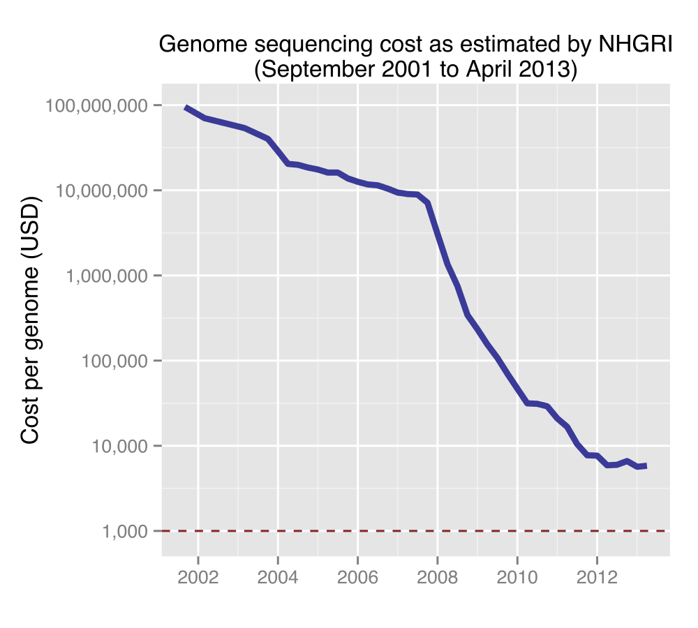
Applications on Human Genomic Data
Genome-Wide Association Studies:
Find putative disease-related genetic markers
Dig into big genomic data
23andMe (https://www.23andme.com/)
PatientsLikeMe (http://www.patientslikeme.com/)
……
Notes:
With the phenomenal advance in DNA sequencing technologies, the cost of genome sequencing is steeply dropped.
More and more human genomic data becomes available.
Researchers developed many applications on it. They discover putative disease-related genetic markers on genomic data of a case group and a control group, typically in the form of single-nucleotide polymorphism (SNP).
There are other emerging applications like 23andme and patientslikeme.

Slide 3
Privacy in Human Genomic Data
Phenotype inference
Re-identification risk by statistical inference techniques
Homer et al.
Sankararaman et al.
Wang et al.
Homer, N., Szelinger, S., Redman, M., Duggan, D., Tembe, W., Muehling, J., … Craig, D. W. (2008). PLoS Genetics, 4(8), e1000167. doi:10.1371/journal.pgen.1000167
Sankararaman, S., Obozinski, G., Jordan, M. I., & Halperin, E. (2009). Nature Genetics, 41(9), 965–7. doi:10.1038/ng.436
Wang, R., Li, Y., Wang, X., & Tang, H. (2009). Proceedings of the 16th.
Notes:
However, phenotype information, such as eye and hair color, can be inferred from genomic data
There also exists re-identification risk. Several statistical methods have been proposed to determine the presence of a patient in a case group by comparing her alleles with the allele frequencies of the case group and those of a reference population. Two example methods are shown here.
Even the results of association studies leak out sensitive user information, which could be leveraged to identify GWAS participants.
These findings caused data owners to remove all aggregate GWAS data from public website.
This situation urges data owners to do privacy preserved data sharing

Slide 4
Differential Privacy
$ε$ Differential Privacy:
A randomized algorithm $Ag$ is differentially private if for all datasets $D$ and $D’$, where their symmetric difference contains at most one record, and for all possible anonymized datasets $\hat{D}$,
Notes:
Differential privacy can help.
A randomized algorithm is $ϵ$ differentially private if for all datasets $D$ and $D’$, where their symmetric difference contains at most one record, and for all possible output datasets, this condition is satisfied.
In simple terms, one modification of a dataset doesn’t significantly affect its output distribution when epsilon is small

Slide 5
Differential Privacy Cont’d
Sensitivity:
For any function $θ$: $D→R$, the sensitivity of $θ$ is
for all $D$, $D′$ with $|D∆D^{′}|≤1$.
Notes:
The amount of random noises that need to be added to the output of a computation to achieve differential privacy depends on the sensitivity of the computation.
Sensitivity measures the maximal change when one modification happens to a dataset.

Slide 6
Naïve Algorithm
Treat each allele count pair $(f_{minor},f_{major})$ as a histogram
Sensitivity over $n$ SNP sites is $2n$
Add Laplacian noises to $f_{minor},f_{major}$
Notes:
Given the concept of differential privacy, we first come up with a naïve algorithm.
It’s very simple and used as baseline in task 1.
We treat each allele count pair as a histogram. So, sensitivity over n SNPs is 2 times n. We next add Laplacian noises to allele counts

Slide 7
Naïve Algorithm Cont’d
Alleles from 262 to 277 on dataset 1 in task 1
Pos | 262 | 263 | 264 | 265 | 266 | 267 | 268 | 269 | 270 | 271 | 272 | 273 | 244 | 275 | 276 | 277
Major | T | C | T | T | C | A | C | T | T | G | T | G | C | G | C | A
Minor | G | A | C | C | T | G | T | A | A | A | C | C | T | A | T | G
Notes:
This table shows major alleles and minor alleles from 262 to 277 on dataset 1 in task 1. In naïve algorithm, count of each allele in the data is calculated. Laplacian noise is added to the count of each allele and then counts are normalized on each SNP sites.

Slide 8
Results
 |  |  | FDR | # of significant SNPs
D1 | Power | 0.05
 | 5e-2 | 19/263 | 0.844 | 22
 | 1e-3 | 12/238 | 0.774 | 19
 | 1e-5 | 9/217 | 0.700 | 14
D2 | Power | 0.04
 | 5e-2 | 42/565 | 0.924 | 45
 | 1e-3 | 12/526 | 0.862 | 15
 | 1e-5 | 5/480 | 0.788 | 8
Notes:
Power is calculate at 95 percent confidence level. So here power is 0.05 means there is no re-identification risk.
When the threshold is 0.05, 263 SNPs are significant in the anonymized data. Among them, 19 SNPs are significant in original dataset.
We can see that there are lots of false positive.

Slide 9
Problem of Naïve Algorithm
High dimension of dataset (i.e., number of SNPs)
→high sensitivity
For a population with $m$ alleles, the space of their SNP sequences in the population is not $2^{m}$
Too much noise needs to be added!
Notes:
The problem of naïve algorithm is that the dimension of dataset is very high. Here, the dimension of dataset is the number of SNPs. This high dimension results in high sensitivity. However, for a population with m alleles, the space of their SNP sequences is now 2 to m.

Slide 10
Haplotype
Haplotype:
The specific combination of alleles across multiple neighboring SNP sites in a locus
Haplotype block (or haploblock) structure is an intrinsic feature of human genome
Haploblocks can be derived from public human genomic data, independent from any given (to-be-protected) sensitive case dataset
Notes:
Here I want to introduce haplotype to you. It’s the specific combination of alleles across multiple neighboring SNP sites in a locus. Haplotype block structure is an intrinsic feature of human genome. They can be derived from public human genomic data, independent from any given sensitive case dataset.

Slide 11
Haplotype Cont’d
The first several haplotype blocks on dataset 1 in task 1
Notes:
The picture show the first several haploblocks on dataset 1 in task 1. we can see that about 50 percent of all samples have the pattern AC-CGTGA and one block with 125 SNPs has17 haplotypes in total. So the combination space over these SNPs is not 2^125, it’s only 17

Slide 12
Haplotype Cont’d
Properties:
Inter-haploblock SNPs are more correlated than intra-haploblock SNPs
The number of potential SNP sequences in each haploblock is significantly lower than the theoretically exponential number
In each haploblock, some haplotypes are more frequent than others
Convert exponential space of SNP sequences to multinomial output
Notes:
Here are some properties of haplotype.
First, second, third.
By using haplotype, we can convert exponential space of SNP sequences to multinomial output

Slide 13
Haplotype-based noise-adding
Break a genomic locus consisting of many SNPs into haplotype blocks
Treat each haplotype block as a random variable that takes a set of potential haplotypes in the block as its possible values
Different haplotypes can be viewed as independent from each other
Reduce the dimensions of the SNP sequences by effectively one order of magnitude (because an average haplotype block span ~10-30 SNPs)
Notes:
So we proposed Haplotype-based algorithm to achieve differential privacy.
By using haplotype, we can reduce the dimensions of the SNP sequences by effectively one order of magnitude

Slide 14
Haplotype-based algorithm
Haplotype blocks from 262 to 277 on dataset 1 in task 1
Block 9 | Block 10 | Block 11
TACCCGCTAGC TCTTCACTTGT GACTTACAAAC GACTCATTAAC GACTCACTAAT | CT GC | GTA ACA GCG GCA
Notes:
This table shows haplotype blocks from SNPs on the previous slide. There are 3 haploblocks over 16 SNPs. In haplotype-based algorithm, count of each haplotypes is calculated. Laplacian noise is added to the count of each haplotype and then counts are normalized on each haploblocks.

Slide 15
Results
 |  | Naïve algorithm |  | Haplotype-based algorithm |  | # of significant SNPs
 |  |  | FDR |  | FDR
D1 | Power | 0.05 |  | 0.05
 | 5e-2 | 19/263 | 0.844 | 22/246 | 0.775 | 22
 | 1e-3 | 12/238 | 0.774 | 19/229 | 0.719 | 19
 | 1e-5 | 9/217 | 0.700 | 14/209 | 0.657 | 14
D2 | Power | 0.04 |  | 0.085
 | 5e-2 | 42/565 | 0.924 | 45/537 | 0.869 | 45
 | 1e-3 | 12/526 | 0.862 | 15/499 | 0.812 | 15
 | 1e-5 | 5/480 | 0.788 | 8/357 | 0.579 | 8
Notes:
The results of haplotype-based algorithm show that the re-identification risk is eliminated and the false positive rate is reduced.

Slide 16
Haplotype-based Algorithm with Unequal Weight
We need to allocate the privacy budget into haploblocks so that the total budget is not over-spent
Our previous approach allocates the same budget to each haploblock. Can we do this better?
Unequal budget allocation
Intuition: haploblocks with more haplotypes -> more complex distributions for SNPs -> more deviated from their actual values
Less noise to be added to more complex haploblocks (with more haplotypes)
Notes:
We need to allocate the privacy budget into haploblocks so that the total budget is not over-spent. Our previous approach allocates the same budget to each haploblock. One question is Can we do this better? An intuition is that in haploblocks with more haplotypes, SNPs in those haploblocks have more complex distributions, and counts of them are more deviated from their actual values. So we can add less noises to more complex haploblocks. Please notice that the total privacy budget is still 1.

Slide 17
Haplotype-based algorithm with Unequal weight Cont’d
Haplotype blocks from 262 to 277 on dataset 1 in task 1
Block 9 (5) | Block 10 (2) | Block 11 (4)
TACCCGCTAGC TCTTCACTTGT GACTTACAAAC GACTCATTAAC GACTCACTAAT | CT GC | GTA ACA GCG GCA
Notes:
Over SNPs on previous slide, there are five haplotypes in block 9, and the count of each allele is affected by counts of multiple haplotypes. There are only 2 haplotypes in block 10, the count of each allele is only affected by one haplotype. So we add less noises to block 9 and more noises to block 10

Slide 18
Results
 |  | Naïve algorithm |  | Haplotype-based algorithm |  | Unequal-weight haplotype-based algorithm |  | # of significant SNPs
 |  |  | FDR |  | FDR |  | FDR
D1 | Power | 0.05 |  | 0.05 |  | 0.03
 | 5e-2 | 19/263 | 0.844 | 22/246 | 0.775 | 20/197 | 0.612 | 22
 | 1e-3 | 12/238 | 0.774 | 19/229 | 0.719 | 19/163 | 0.493 | 19
 | 1e-5 | 9/217 | 0.700 | 14/209 | 0.657 | 14/155 | 0.475 | 14
D2 | Power | 0.04 |  | 0.085 |  | 0.115
 | 5e-2 | 42/565 | 0.924 | 45/537 | 0.869 | 44/499 | 0.804 | 45
 | 1e-3 | 12/526 | 0.862 | 15/499 | 0.812 | 15/437 | 0.708 | 15
 | 1e-5 | 5/480 | 0.788 | 8/357 | 0.579 | 8/312 | 0.504 | 8
Notes:
The results show that the false positive rate is further reduced.

Slide 19
Future Works
Privacy preserved data selection
Privacy preserved big data sharing and processing
Notes:
For future works, we think privacy preserved data selection is important.
Disease-related genetic markers can only be captured from the dataset where the case and control populations have certain population composition.
The problem is that oftentimes no one knows which population compositions can lead to scientific discoveries. As a result, researchers often have to try out many different datasets before finding what they want.
They have to deal with many data owners and sign many agreements, which is time consuming.
Highly diverse association tests and newly developed association test make this even worse.
Differential privacy is less powerful to big data. How to do big data sharing and processing on public computation platform is a open question

Slide 20
Acknowledgement
NCBC-collaborating R01 (HG007078-01) from NIH/NHGRI.
Notes:
Thank the grant supporting our research

