Slide 1
Genomic Data Privacy Protection Using Compressive Sensing
University of Oklahoma -Tulsa
Aminmohammad Roozgard,
Nafise Barzigar,
Dr. Pramode Verma,
Dr. Samuel Cheng

Slide 2
Today’s Presentation
Privacy concerns of releasing genomic data
Wavelet transformation
Compressive sensing introduction
Proposed compressive sensing based solutions
Results of proposed mechanisms
Notes:
In this presentation, I going to state the problem of releasing genomic data to public, the data owners concerns about Privacy Protection and the researcher concerns about the released data utility.
Then, I will talk about a hot topic, compressed sensing, that is the inspiration of current research project.
After that the detail of proposed genome privacy protection mechanism based on compressed sensing will be explained and I will conclude the presentation by demonstrating the result of proposed method and a quick review of this research future plan.

Slide 3
Problem Statement
Most genomic datasets are not publicly accessible, due to privacy concerns
Patients’ genomic data contain identiﬁable markers
Individuals can be identify by:
A very small set of SNPs (Lin et. al. 2004)
The frequencies of different SNPs across a population (Homer et. al. 2008)
Agreements (e.g., IRB approval or consents) need to be signed before data use is permitted
Notes:
Most genomic datasets are not publicly accessible, due to privacy concerns. Patients genomic data contains identifiable markers and can be used to determine the presence of an individual in a dataset.
Prior research shows that the identification can be happened when:
there is a very small set of SNPs,
Or the genomic data has been aggregated; like releasing the frequencies of different SNPs values across a population.
To protect patients, the data owners impose an application and evaluation procedure. Then an agreement needs to be signed before the use of data is permitted. This process often takes months to complete and limits the researchers.

Slide 4
Our Team’s Solution
Create pilot datasets that protected patients privacy while accessible by researchers
Two-steps mechanism:
Data owners publish a set of pilot data
Add noise to the original genomic data
Release noise parameters and disturbing mechanism
Data users choose the right datasets according to their needs
Run different tests over the pilot data
Compare their outcomes
Sign agreement to get access
Notes:
The solution to the problem can be to let each data owner publish a set of pilot data to help data users choose the right datasets based on their needs.
Such pilot data comes from adding noise to the original genomic data to ensure that individuals’ information is protected. The data owners release these pilot data with the noise parameters and the mechanism that they used. It does not offer any utility guarantee when it is used for disease marker discovery, but a data user can download it, run different kinds of association tests including those that are unknown to the data owners and compare the outcomes with the other datasets outputs to get an idea which datasets can be useful.
With such information, the researchers can approach the owners of the most relevant datasets and sign agreements with them. This allow one to just go for a small set of most valuable targets.

Slide 5
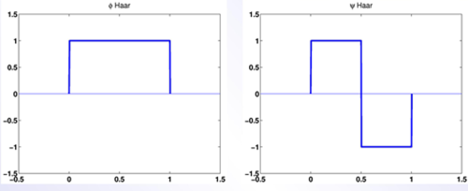
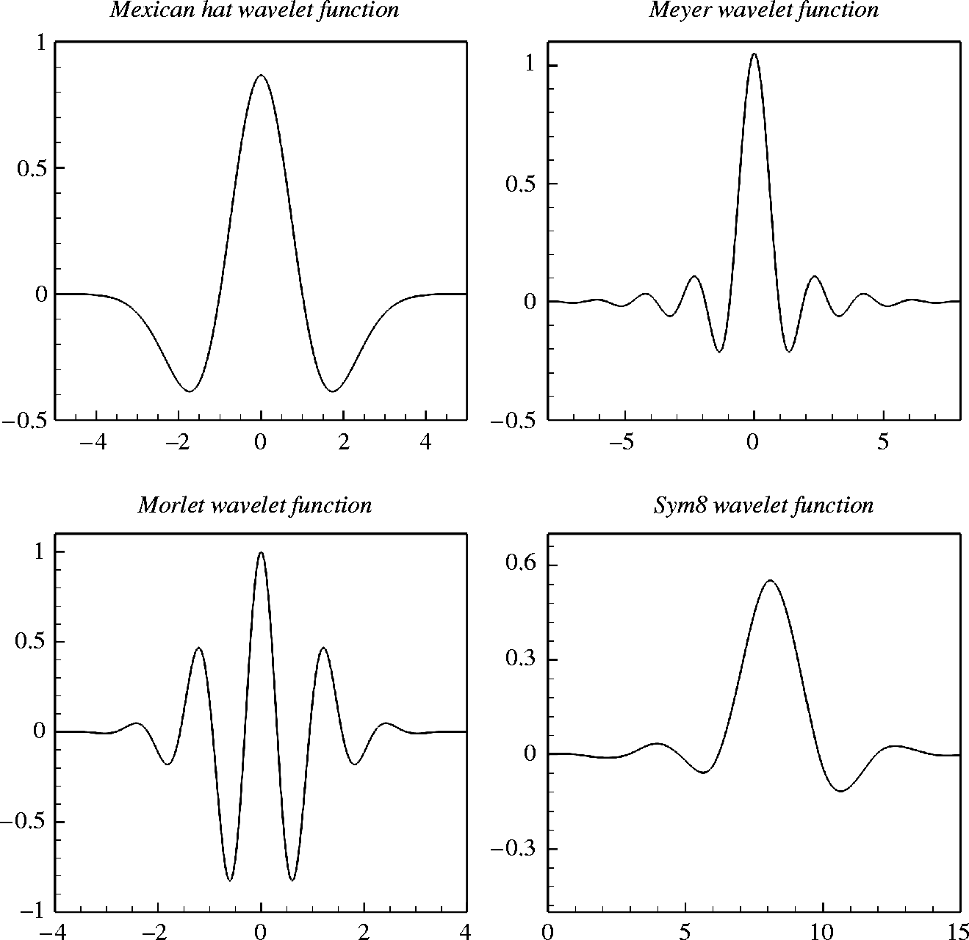
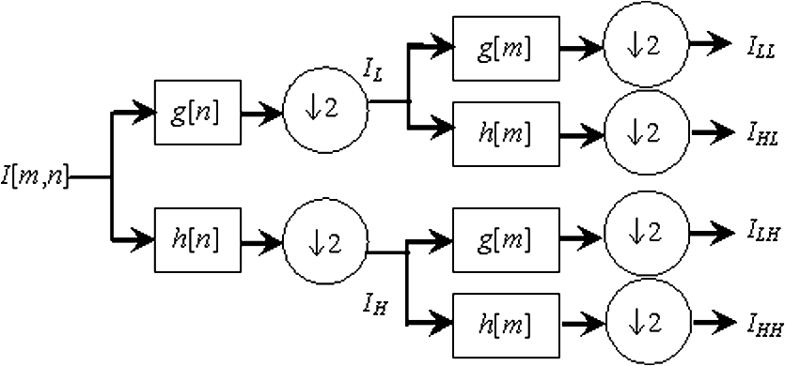
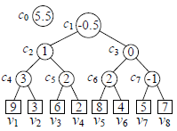
Wavelet Transform (1)
Wavelet functions
Wavelet Levels
Notes:
In mathematics, a wavelet series is a representation of a square-integrable (real- or complex-valued) function by a certain orthonormal series generated by a wavelet.
Nowadays, wavelet transformation is one of the most popular candidates of the time-frequency-transformations.
The fundamental idea of wavelet transforms is that the transformation should allow only changes in time extension, but not shape. This is effected by choosing suitable basis functions that allow for this
When Δt is large, 1) Bad time resolution 2)Good frequency resolution 3)Low frequency, large scaling factor
When Δt is small, 1)Good time resolution 2)Bad frequency resolution 3)High frequency, small scaling factor
.

Slide 6
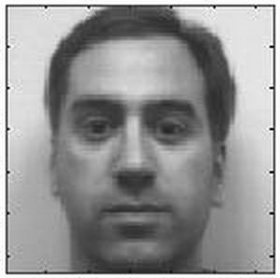
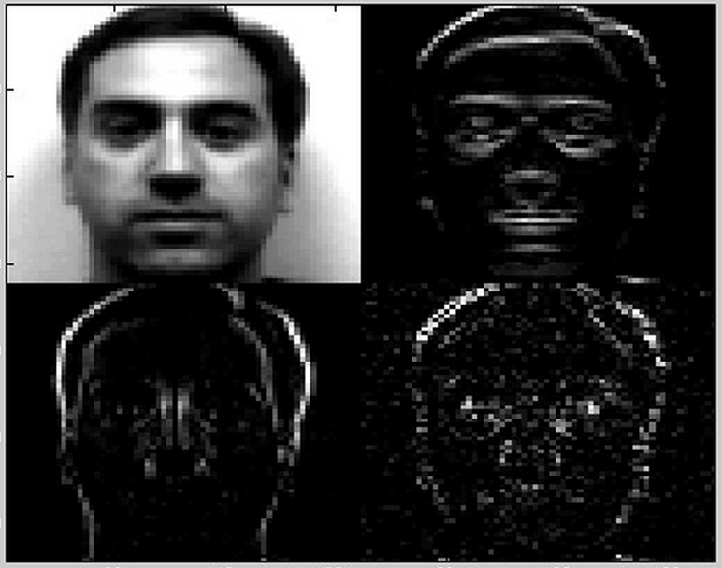
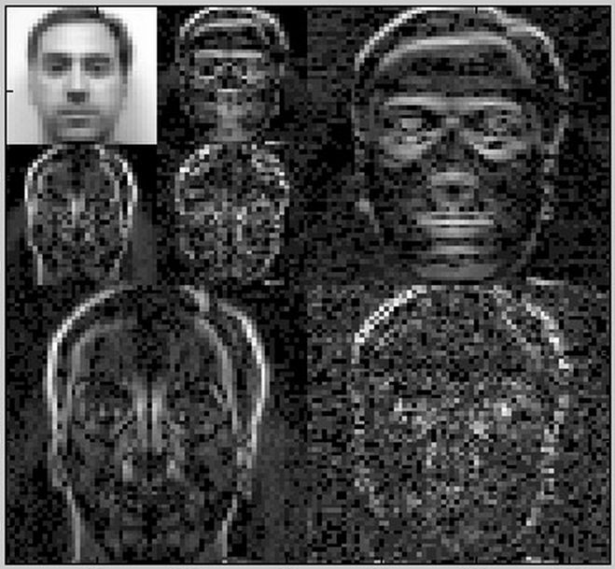
Wavelet Transform (2)
http://www.owlnet.rice.edu/~elec539/Projects97/morphjrks/moredge.html

Slide 7
Inspiration of Compressed Sensing
Most signals in our natural world are sparse
Diagram: Emmanuel Candès, Michael Wakin
1000*1000 pixels
Reconstructed by 25,000 coefficients
Notes:
The inspiration of this research coming from the success of compressed sensing in the area of image and signal processing. Many signals in the nature have sparse representations when they are expressed in the transformation domain. For example, in the left hand side image you can see a 1000*1000 pixel image and its wavelet transform in the middle. As you can see, the image pixels have nonzero values, while the most wavelet coefficients are small, and the relatively few large coefficients capture most of the information. The image on right hand side is the reconstructed image obtained by zeroing out all the coefficients in the wavelet expansion except the 25,000 largest. The difference with the original picture is hardly noticeable.

Slide 8
Compressive Sensing
Sampling process
Reconstruction process
Notes:
In this slide I will give a brief overview of the theory of compressive sensing. The compressive sensing consists of a probabilistic compression procedure, also called the sampling process, followed by a reconstruction process that decodes the compressed data. The reconstruction process exactly or approximately reconstructs the original data from the compressed samples.

Slide 9
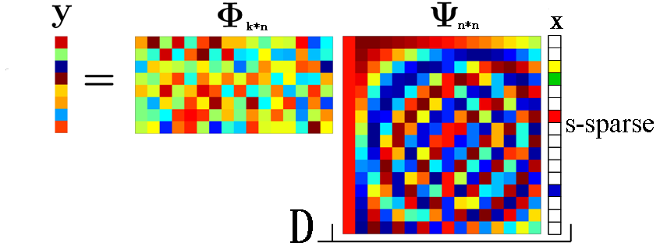
Compressive Sensing
Sampling process
Reconstruction process
Notes:
The final step is to reconstruct the vector D from its random projection y. We consider A as the inner product of Phi by Psi which both Phi and Psi are known from the sampling process. Using a L1-Norm minimization method, the recovered answer x can be close enough to the original x even in the presence of noise. The minimizer will select the smallest set of columns from A that keeps A*x similar enough to y.

Slide 10
Compressive Sensing
Sampling process
Reconstruction process
Notes:
The final step is to reconstruct the vector D from its random projection y. We consider A as the inner product of Phi by Psi which both Phi and Psi are known from the sampling process. Using a L1-Norm minimization method, the recovered answer x can be close enough to the original x even in the presence of noise. The minimizer will select the smallest set of columns from A that keeps A*x similar enough to y.

Slide 11
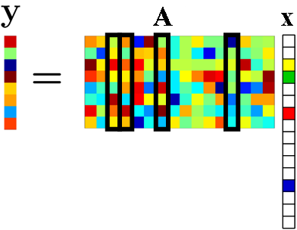
Compressive Sensing
Sampling process
Reconstruction process
Notes:
The final step is to reconstruct the vector D from its random projection y. We consider A as the inner product of Phi by Psi which both Phi and Psi are known from the sampling process. Using a L1-Norm minimization method, the recovered answer x can be close enough to the original x even in the presence of noise. The minimizer will select the smallest set of columns from A that keeps A*x similar enough to y.

Slide 12
Data Preparation
Read the DNA sequences
Mark SNPs location
Extract corresponded SNP sequence for each DNA sequence
Calculate the frequency of each SNP site (minor and major frequencies)

Slide 13
Method Parameters & Difficulties
Random Sampling matrix
Bernoulli Distribution
Wavelet transform matrix

Slide 14
Method Parameters & Difficulties
Random Sampling matrix
Bernoulli Distribution
Wavelet transform matrix
Reconstruction Process
Sparsity of signal (Yang et. al. 2011)
Error threshold
Speed (number of iteration)

Slide 15
Method Parameters & Difficulties
Random Sampling matrix
Bernoulli Distribution
Wavelet transform matrix
Reconstruction Process
Sparsity of signal (Yang et. al. 2011)
Error threshold
Speed (number of iteration)
Noise
How much noise (Xiao et. al. 2009)
Where to add (Cormode et. al. 2011)

Slide 16
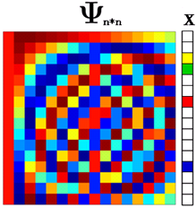
Noise Adding Schema
Noise
*
*
=
Subspace Pursuit
Notes:
In the second mechanism, we are adding noise to the to sparse representation of our genomic data. In this mechanism, the construction of A was the same as pervious mechanism and the SubSpace Pursuit was used to find the best columns in A. Then we add noise to the x which was the solution.

Slide 17
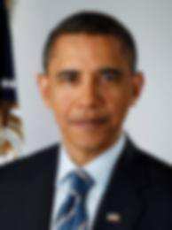
Privacy Protection vs. Image Denosing
Privacy Protection
Image Denoising

Slide 18
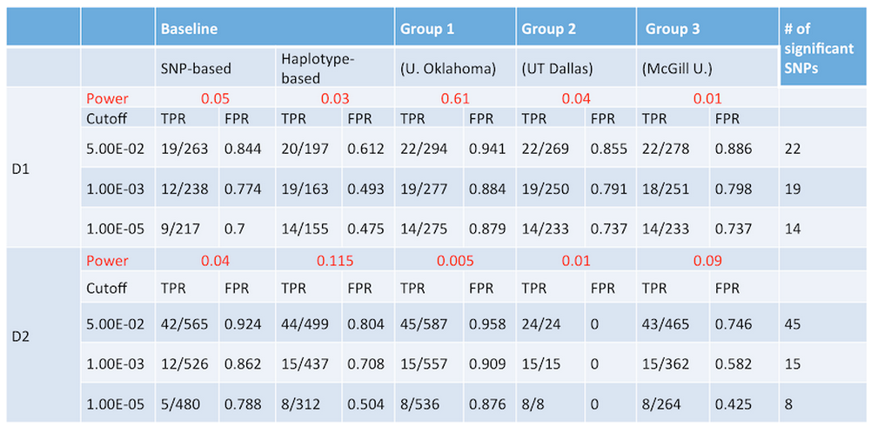
Results
http://www.humangenomeprivacy.org/CADPP_results.html

Slide 19
Genomic Data Privacy Protection Using Compressive Sensing
University of Oklahoma -Tulsa
Aminmohammad Roozgard,
Nafise Barzigar,
Dr. Pramode Verma,
Dr. Samuel Cheng

